Slide 1


Slide 2

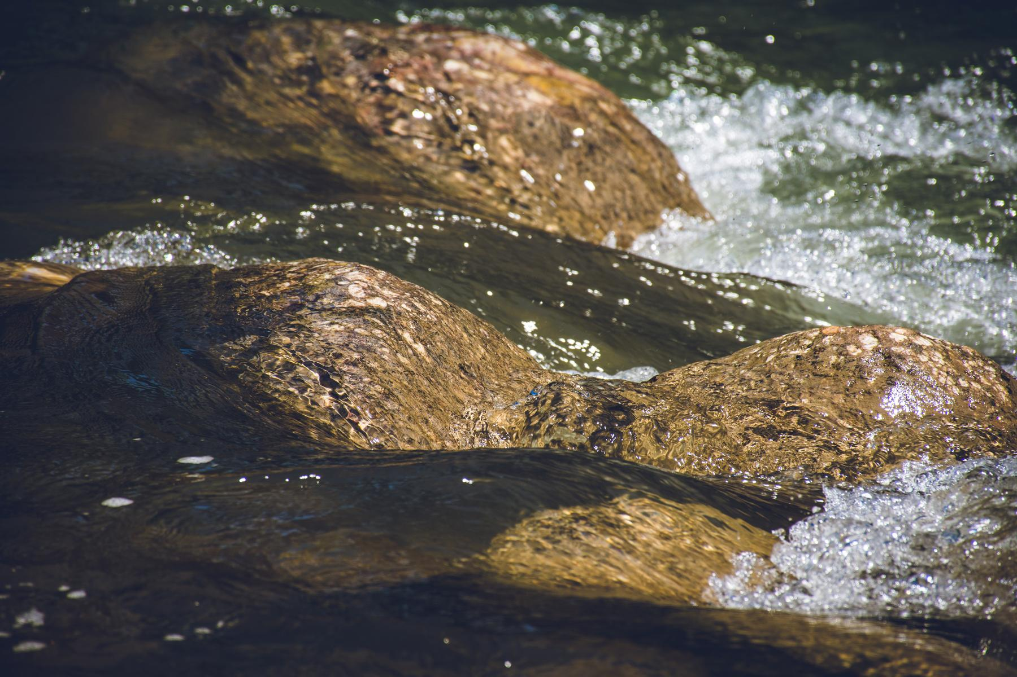
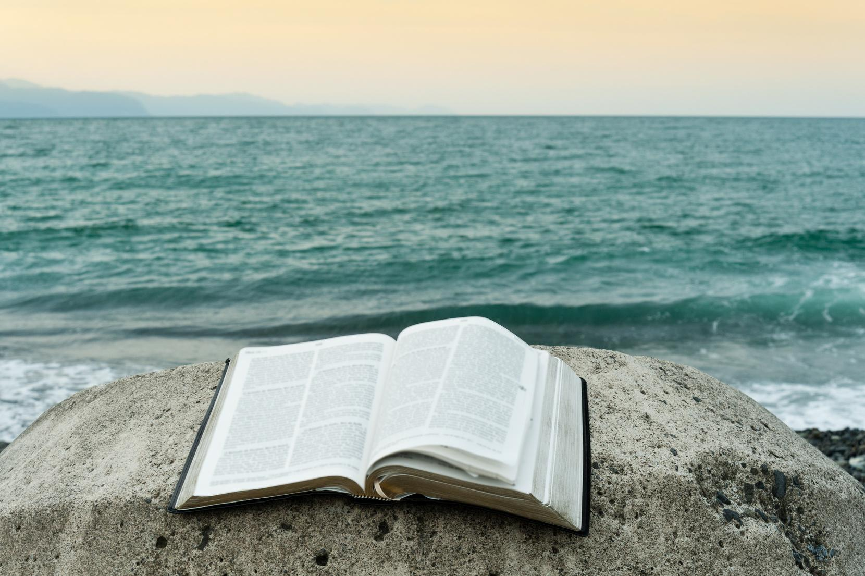
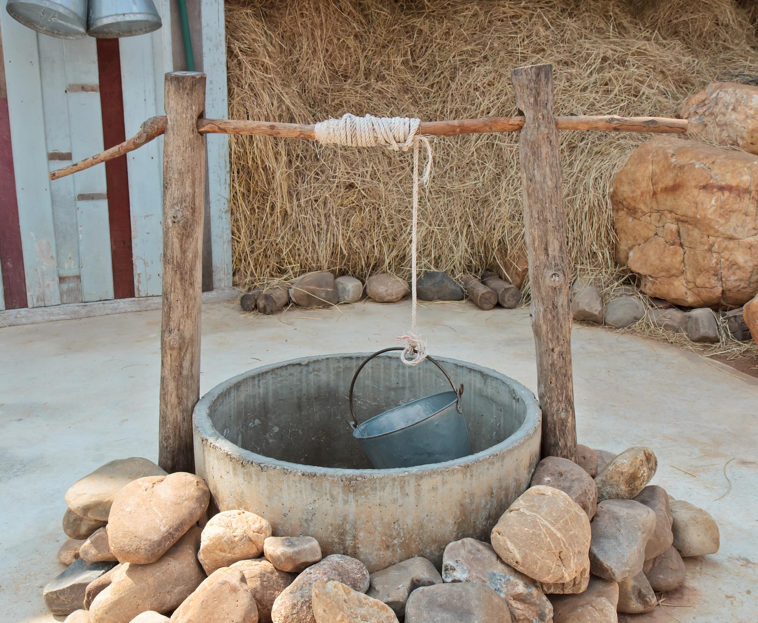
John 4
The Water of Life
Notes:
See notes for materials on Jesus and the Samaritan woman - John 4

Slide 3

John 4v14
"Whoever drinks the water I give them will never thirst. Indeed, the water I give them will become in them a spring of water welling up to eternal life."
NIV
Notes:
Bible verse - John 4v14 "Whoever drinks the water I give them will never thirst. Indeed, the water I give them will become in them a spring of water welling up to eternal life.”

Slide 4
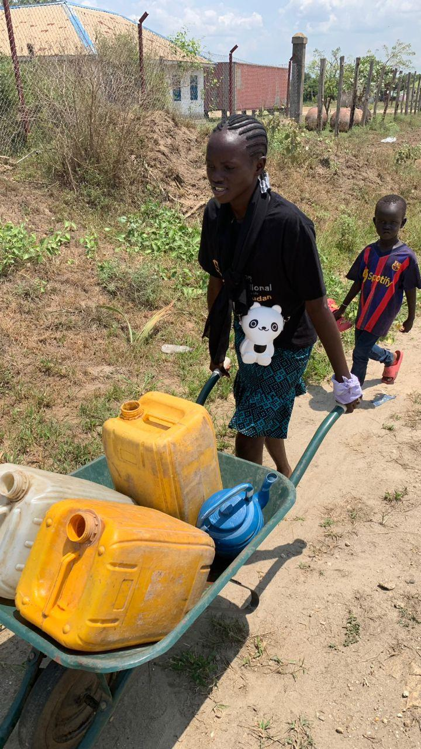
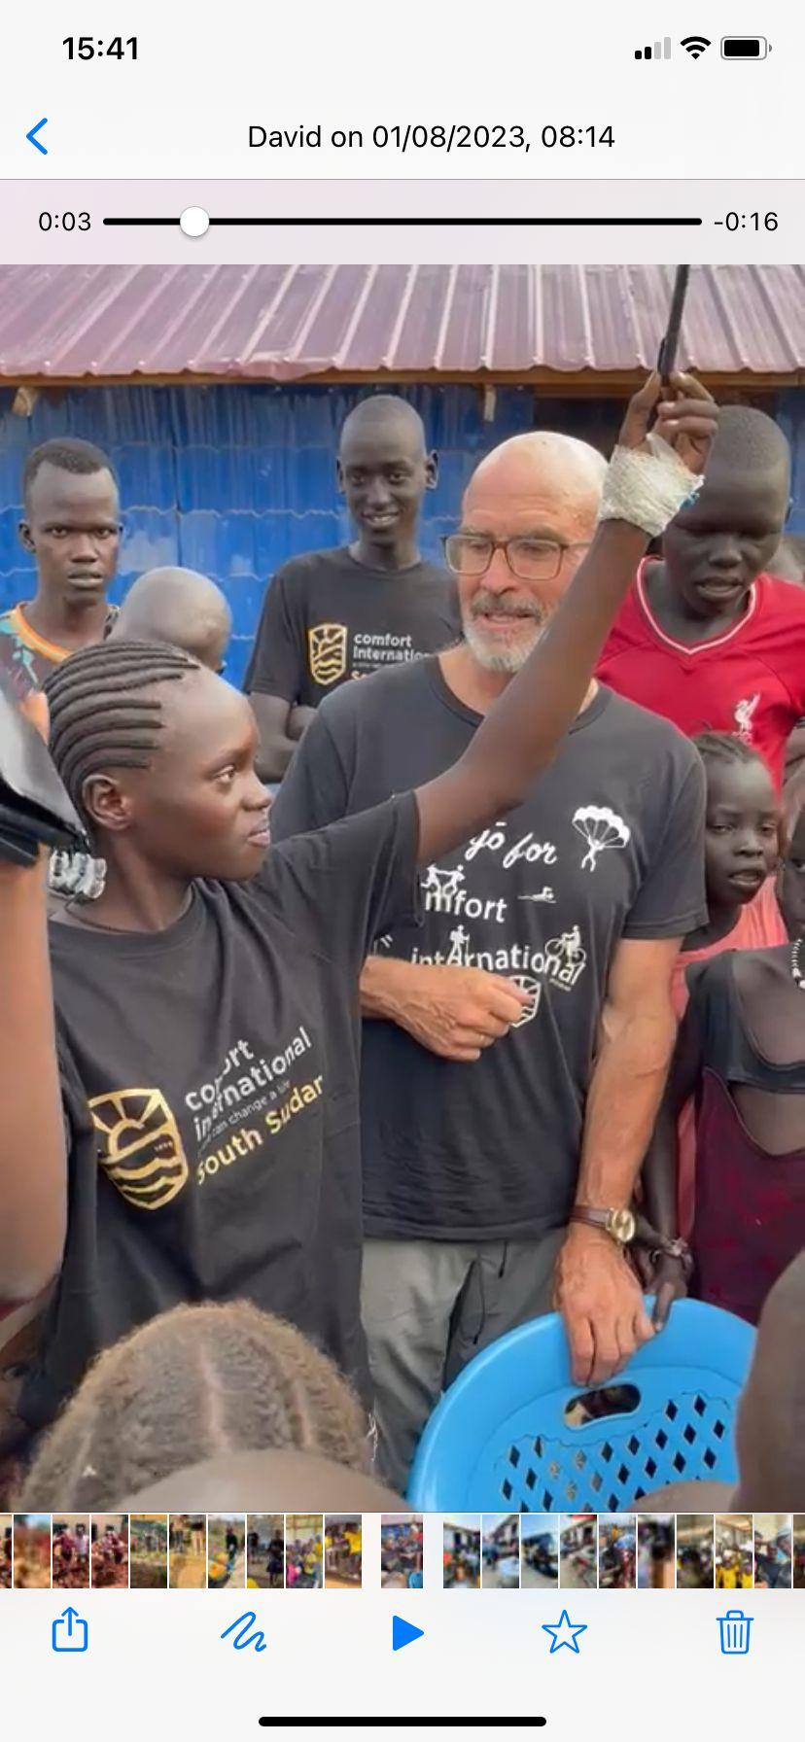
South Sudan
Notes:
We were learning today about places that experience drought and Comfort International is a charity that works in very poor countries across Africa like South Sudan that experience drought every day. Stella is in Primary 7, and had a very difficult childhood, including becoming an orphan when she was just a young child and being badly treated by people who were supposed to look after her. Comfort International have a project in South Sudan which helps children like Stella, and she came onto the project where she received food, water, medical support, education, and very importantly, love and compassion to help heal the wounds of the past. She gave some visitors a challenge, by putting a pen in a plastic bottle and asked them to get it out without touching the bottle. When nobody could do it, she eventually filled the bottle up with water and the pen floated to the top. She said she was like that pen in the past, stuck with no way of getting out, in a bad place and very low. Then, when Comfort International helped her and she met Jesus, it was like the water lifted her up out of that bad place so now she can be happy. That is what Jesus did for Stella and what he can do for you.

Slide 5
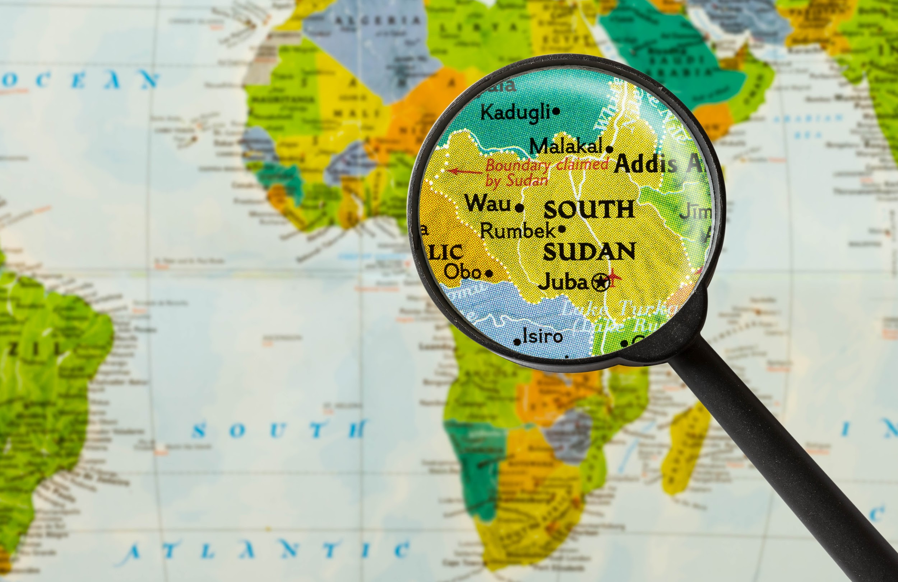
Notes:
Quiz - here are some questions about South Sudan, about water and about the work Comfort International does. How much do you know?

Slide 6
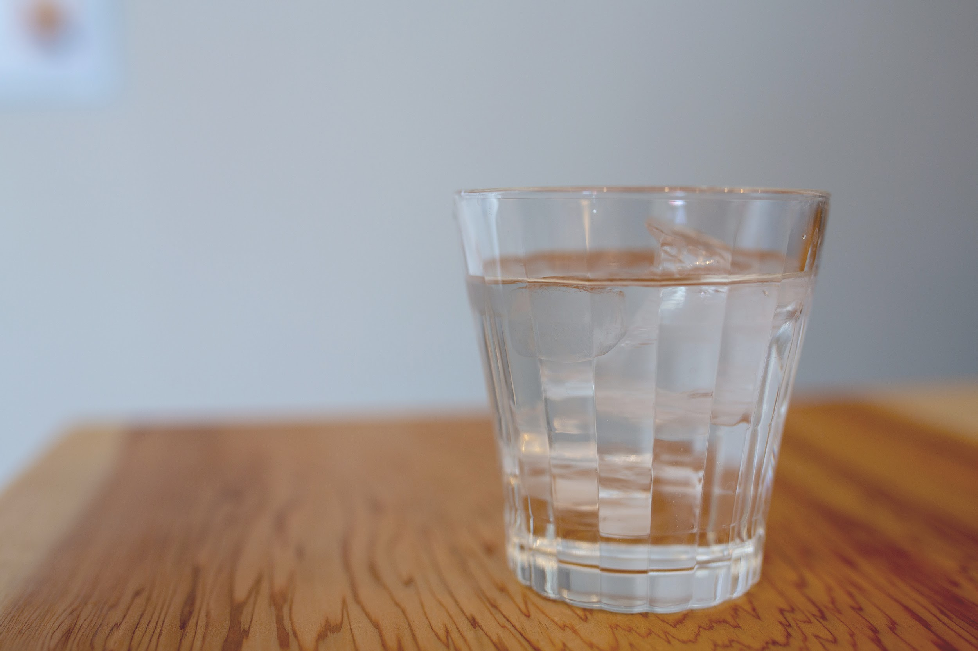
How much water is it recommended to drink in one day?
A. 1 cup
B. 5 cups
C. 9 cups
D. 25 cups
Notes:
How much water is it recommended to drink in one day?
A. 1 cup
B. 5 cups
C. 9 cups
D. 25 cups

Slide 7
C. 9 cups!
Notes:
The answer is C. It is recommended to drink 2 litres of water a day which is equivalent to about 8 or 9 cups of water!

Slide 8
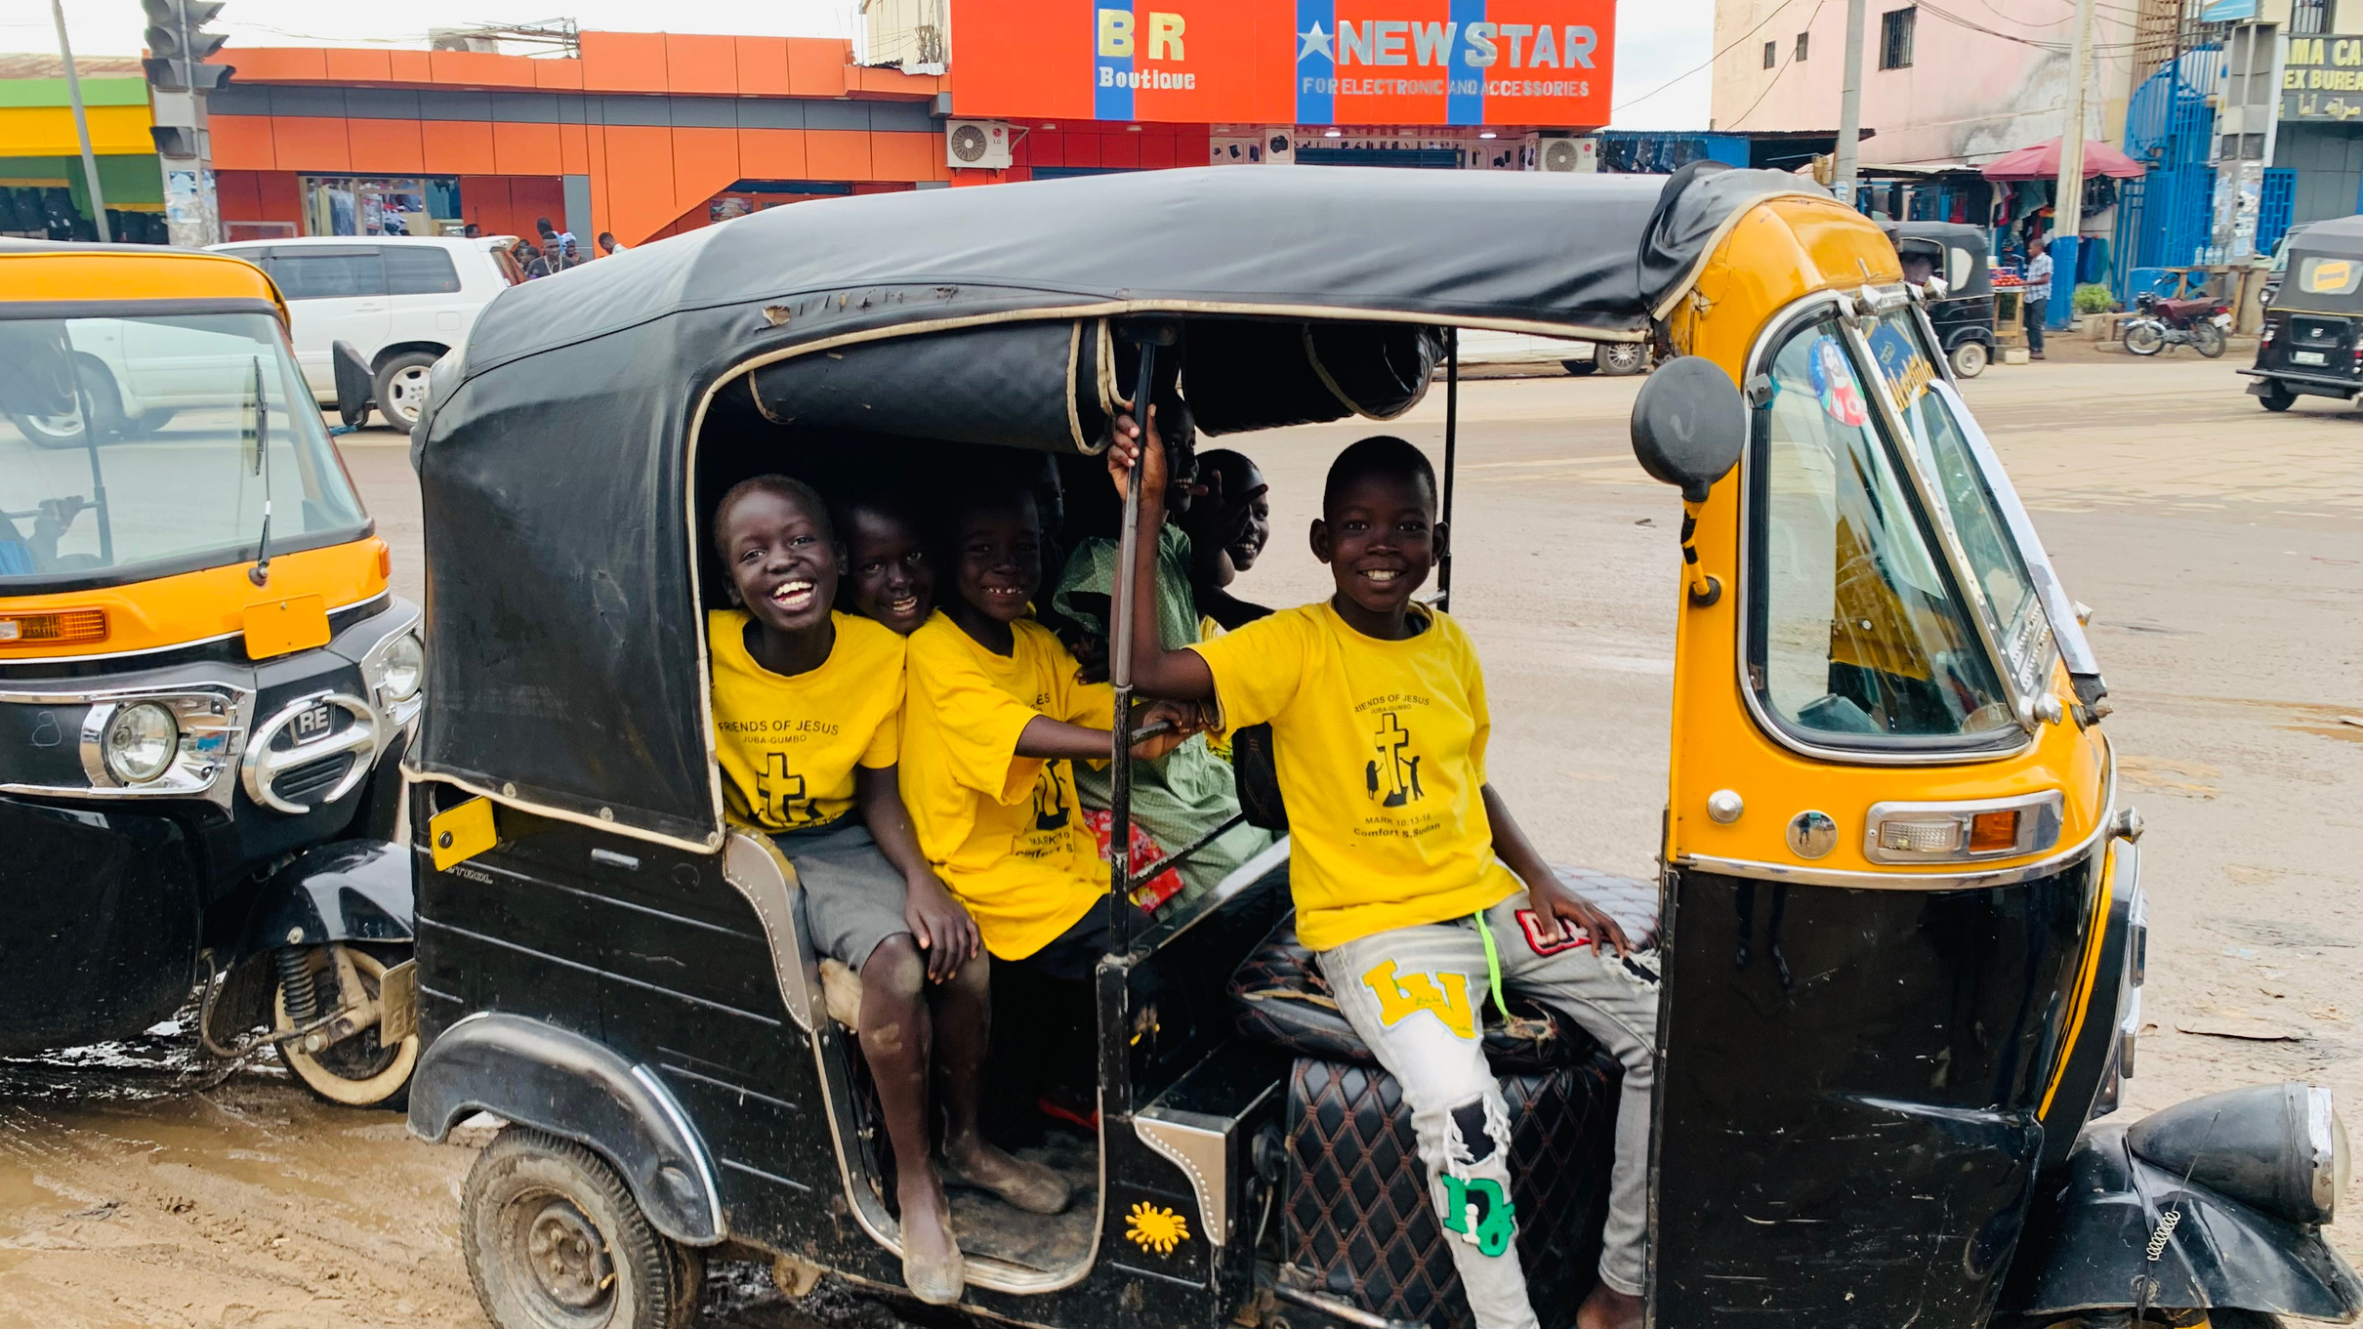
South Sudan is the
A. newest
B. oldest
C. highest
D. lowest country in the world
Notes:
South Sudan is the
A. newest
B. oldest
C. highest
D. lowest country in the world

Slide 9
A. newest
Notes:
The answer is A - South Sudan is the newest country in the world! It became independent in 2011, making it the youngest country in the world.

Slide 10
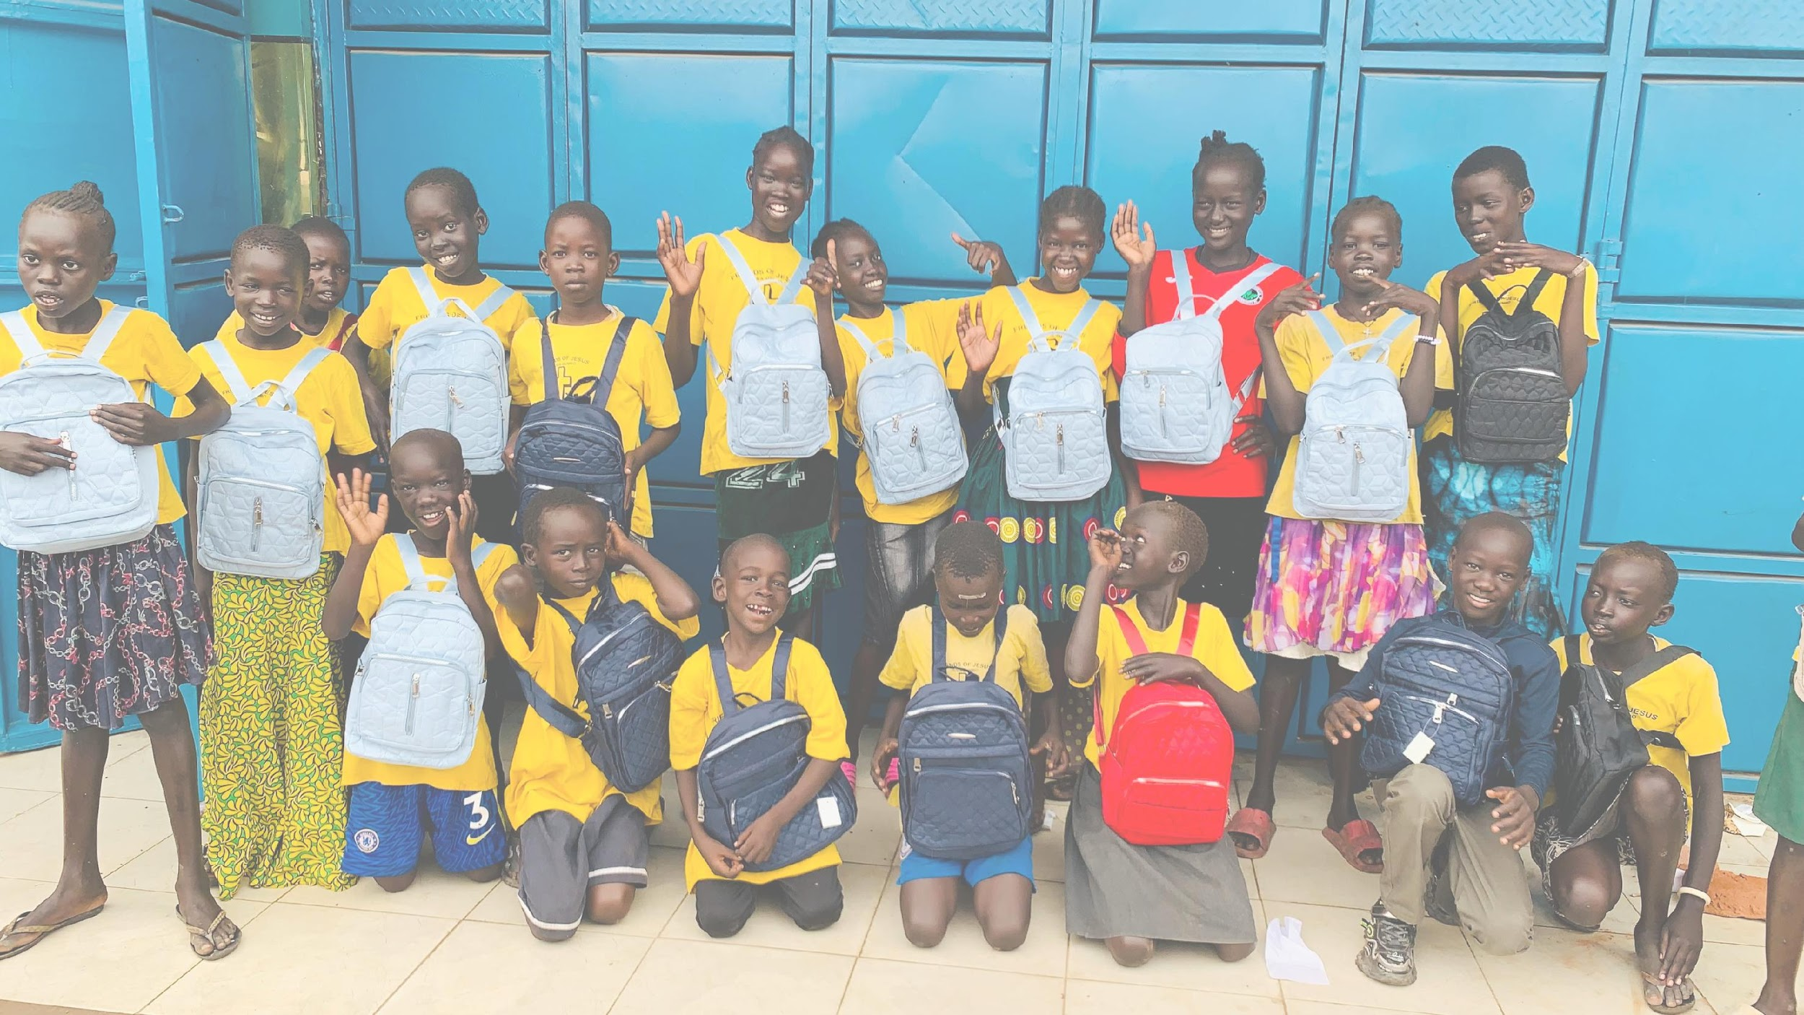
How many languages (and dialects) are spoken in South Sudan?
A. 250
B. 60
C. 10
D. 3
Notes:
How many languages (and dialects) are spoken in South Sudan?
A. 250
B. 60
C. 10
D. 3

Slide 11
B. 60
Notes:
The answer is B. There are around 60 languages spoken in South Sudan, including English, Juba Arabic and many others. Can you say anything in another language?

Slide 12
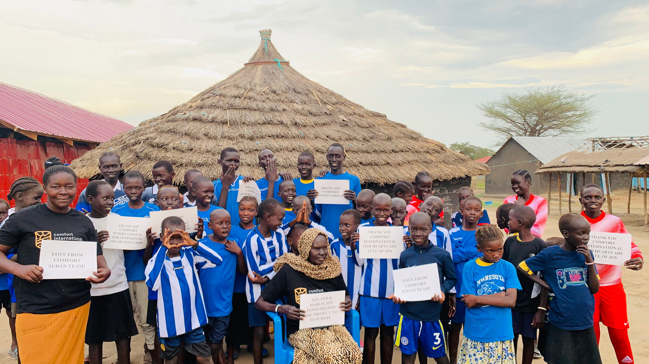
Where is the capital of South Sudan (this is also the location of Comfort International’s projects)?
A. Kinshasa
B. Juba
C. Bujumbura
D. Kigali
Notes:
Where is the capital of South Sudan (this is also the location of Comfort International’s projects)?
A. Kinshasa
B. Juba
C. Bujumbura
D. Kigali

Slide 13
B - Juba!
Notes:
The answer is B - Juba! Kinshasa is the capital of Democratic Republic of Congo, Bujumbura is the capital of Burundi and Kigali is the capital of Rwanda, but Comfort International works in all of these countries.

Slide 14
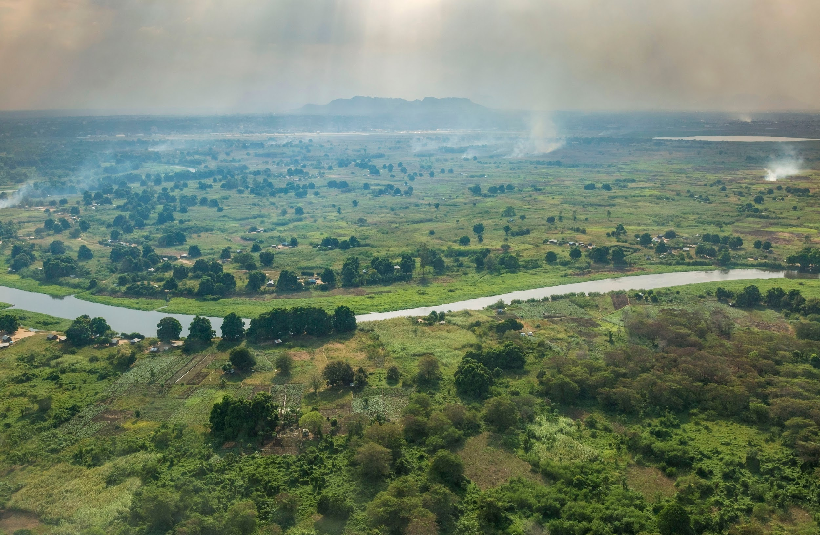
Which river runs through the middle of Juba?
A. The Nile
B. The Zambezi
C. The Amazon
D. The Tay
Notes:
Which river runs through the middle of Juba?
A. The Nile
B. The Zambezi
C. The Amazon
D. The Tay

Slide 15
A. The Nile
Notes:
A - The Nile. More specifically, it is the White Nile, a tributary of the Nile, which runs through South Sudan.

Slide 16
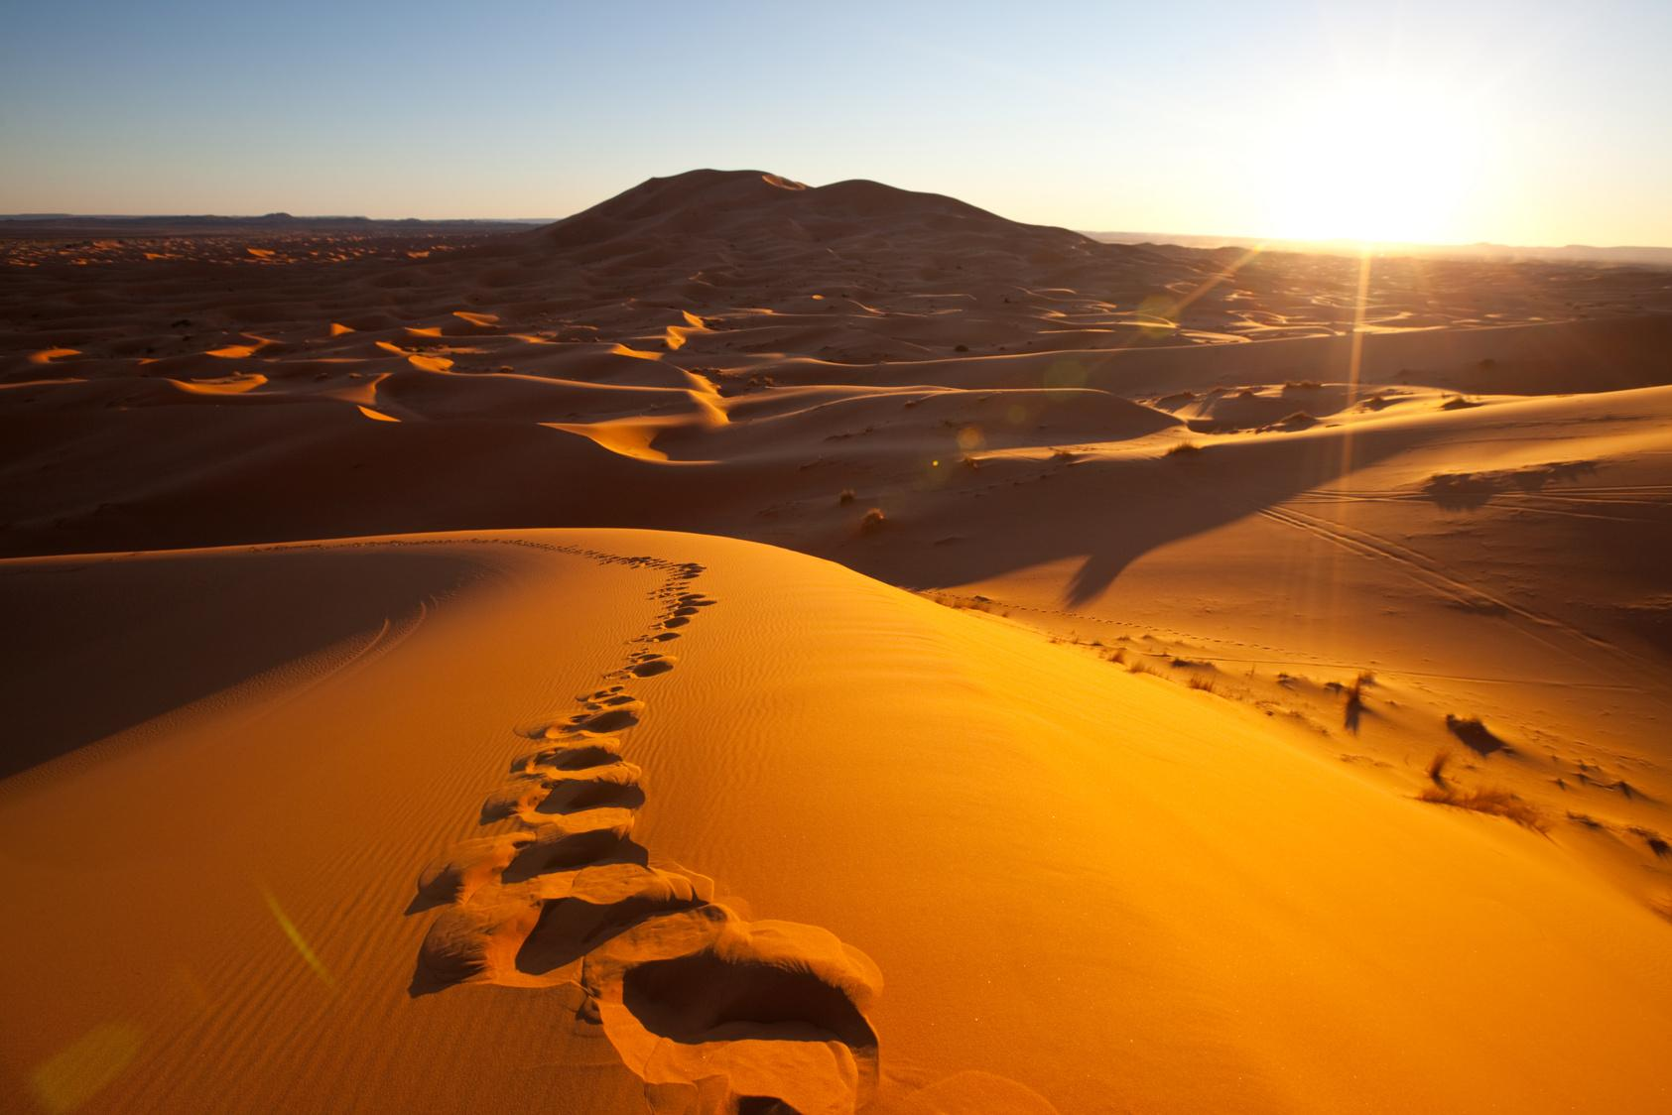
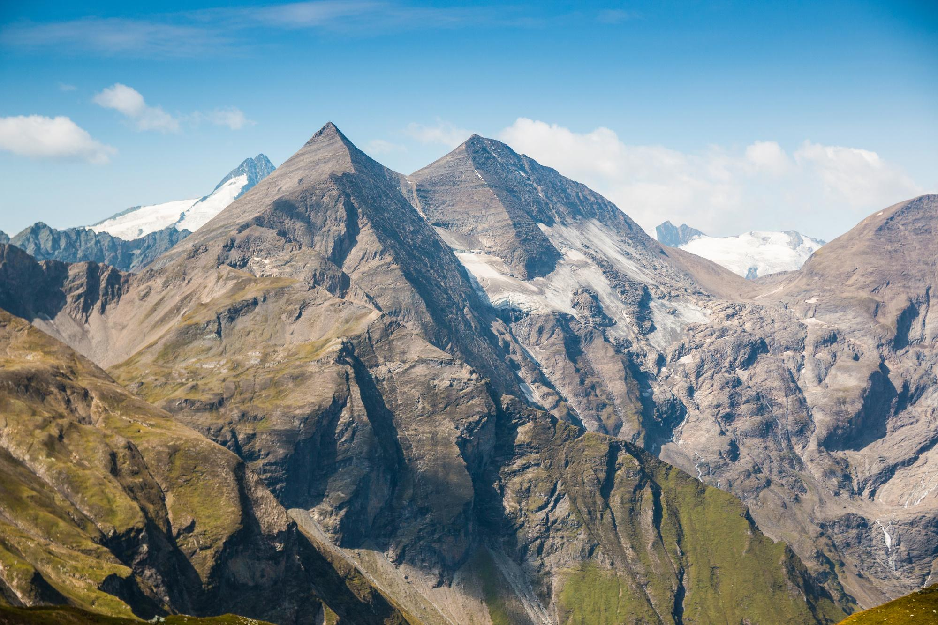
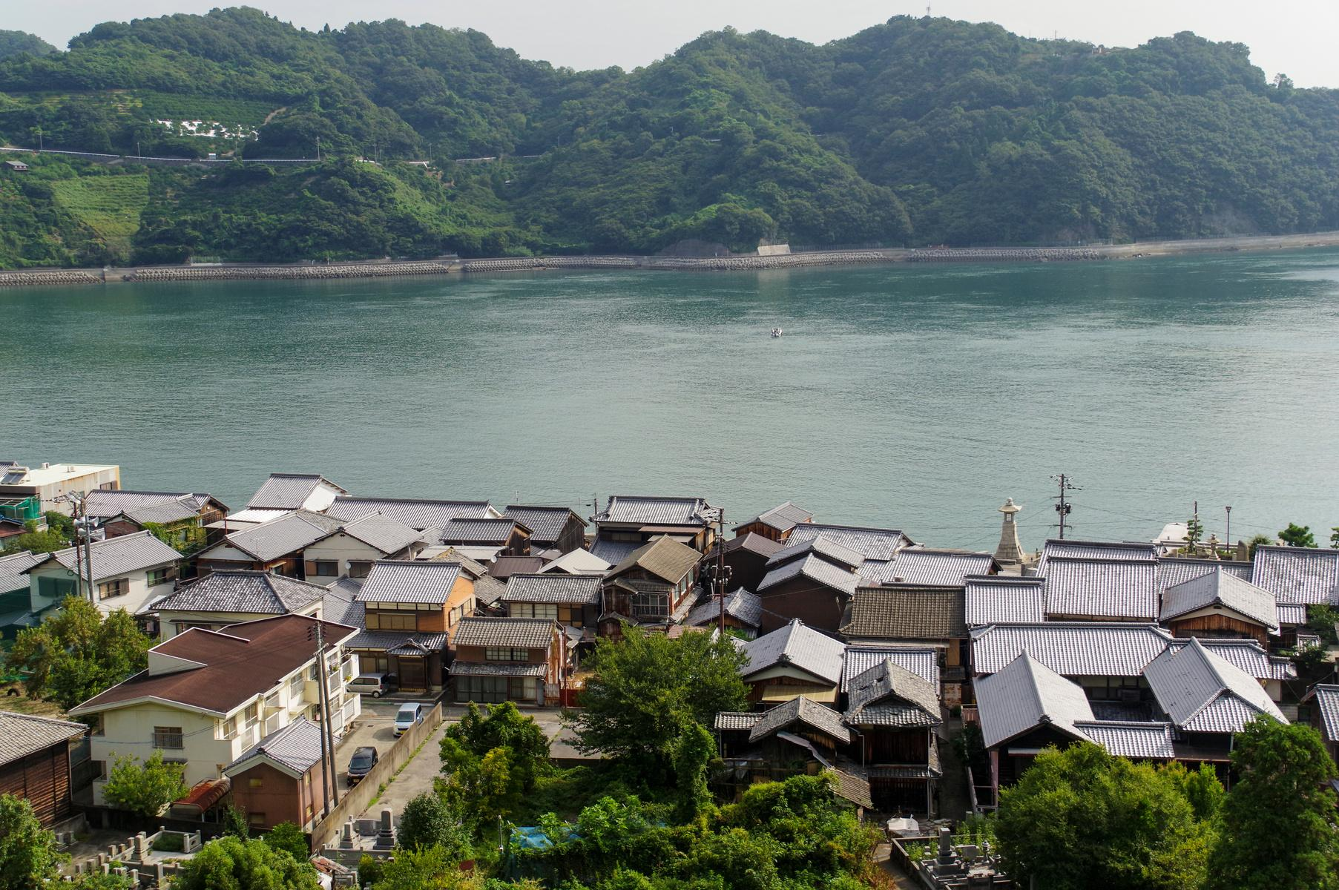
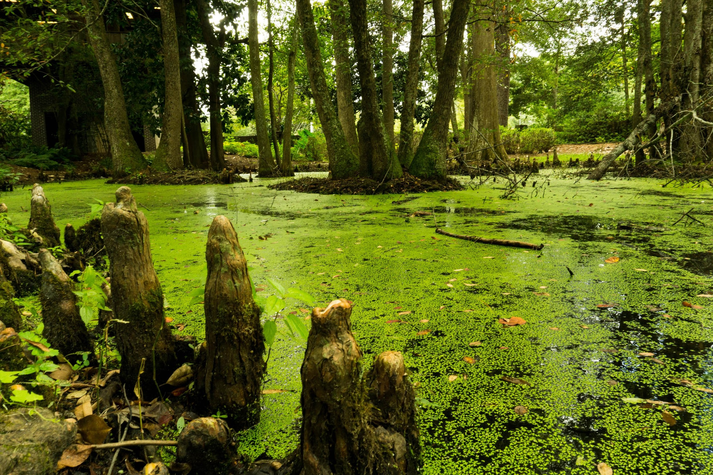
South Sudan has a huge ...
A. Mountain Range
B. Desert
C. Inland Sea
D. Swamp
Notes:
South Sudan has a huge ...
A. Mountain Range
B. Desert
C. Inland Sea
D. Swamp

Slide 17
D - swamp!
Notes:
D - swamp! This was a bit of a trick question, because even though South Sudan experiences droughts, it isn’t in the desert, but it does have a very large swampland called the Sudd.

Slide 18
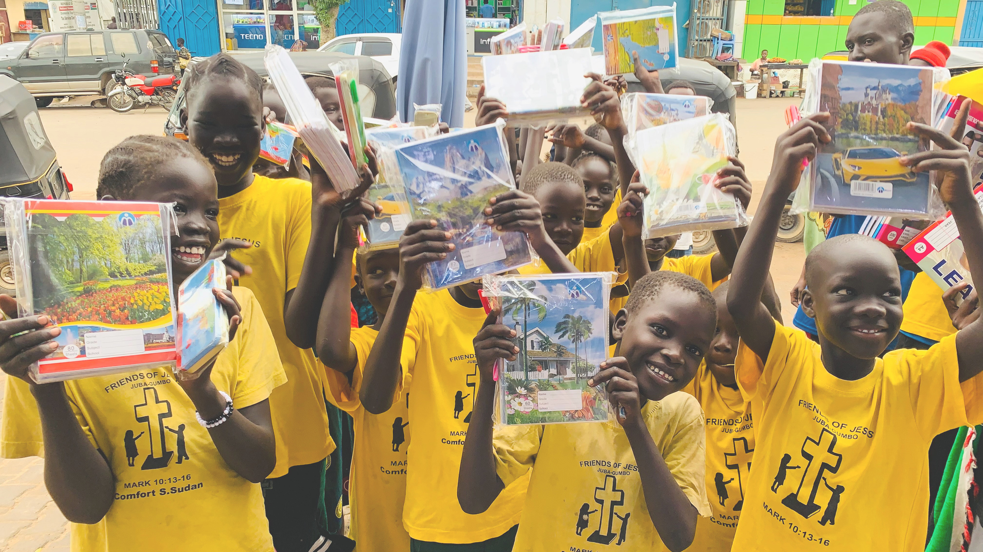
What percentage of girls in South Sudan finish Primary School?
A. 18%
B. 50%
C. 76%
D. 90%
Notes:
What percentage of girls in South Sudan finish Primary School?
A. 18%
B. 50%
C. 76%
D. 90%

Slide 19
A. 18%
Notes:
A - only 18% of girls finish Primary School in South Sudan. This is due to many reasons, as a lot of them need to work at home, and their parents don’t have money to send them to school, or it is not safe for them to go to school because of the war that is going on there.

Slide 20




A.
B.
Which flag belongs to South Sudan?
C.
D.
Notes:
Which flag belongs to South Sudan?

Slide 21
A!
Notes:
A! See if you can name the other countries' flags! (South Africa, Scotland, Rwanda)

Slide 22



Shokran! Thanks for listening!
SCIO SC030369
comfortinternational.org
Notes:
Shokran means thank you in Juba Arabic - one of the main languages spoken in South Sudan.
If you still have time, check out our Take The Challenge page. It’s full of fun activities! Discuss what people can do to help people like Stella live a better life.

