Slide 1



Harvest 2024
Quiz
Sowing Peace, Reaping Righteousness
SCIO SC030369
comfortinternational.org

Slide 2
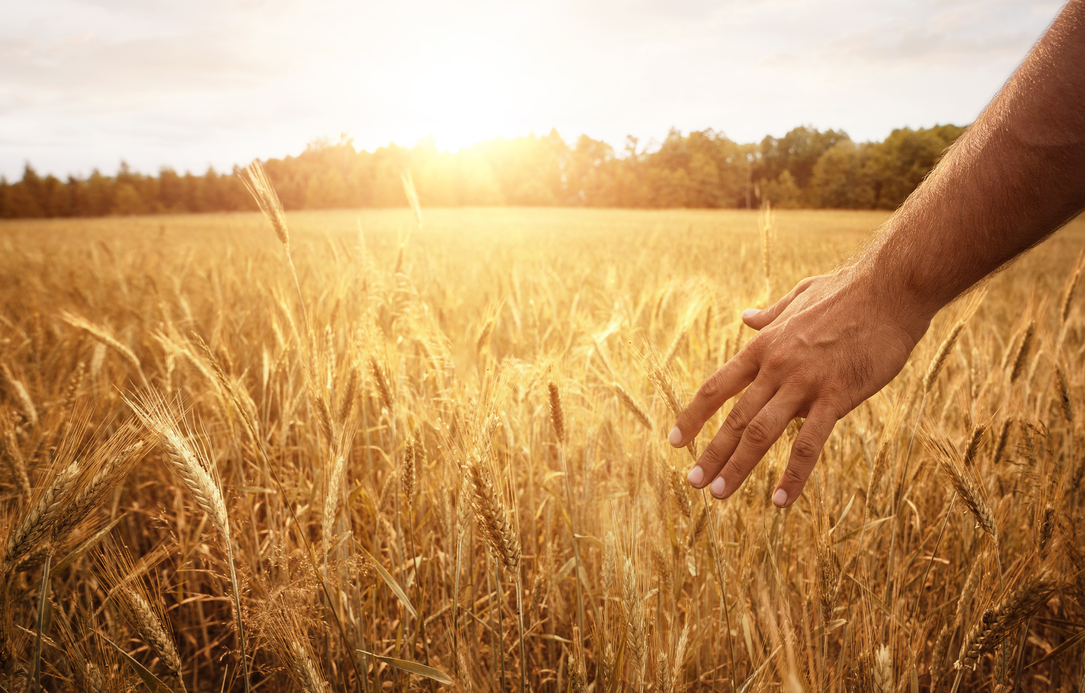

Matthew 5v9: “Blessed are the peacemakers, for they will be called children of God.”
James 3v18: “Peacemakers who sow in peace reap a harvest of righteousness.”
NIV

Slide 3
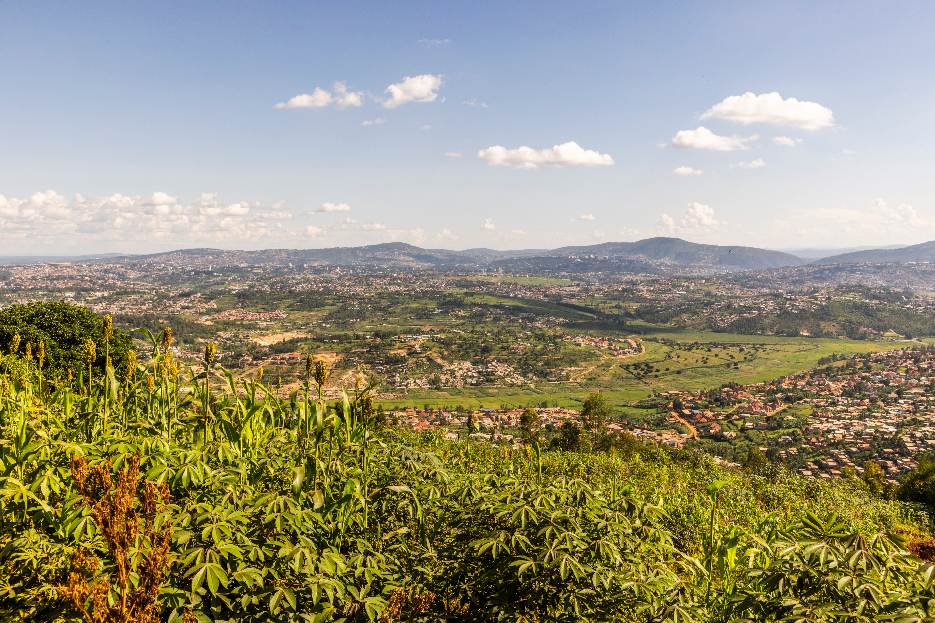
Rwanda Quiz

Slide 4
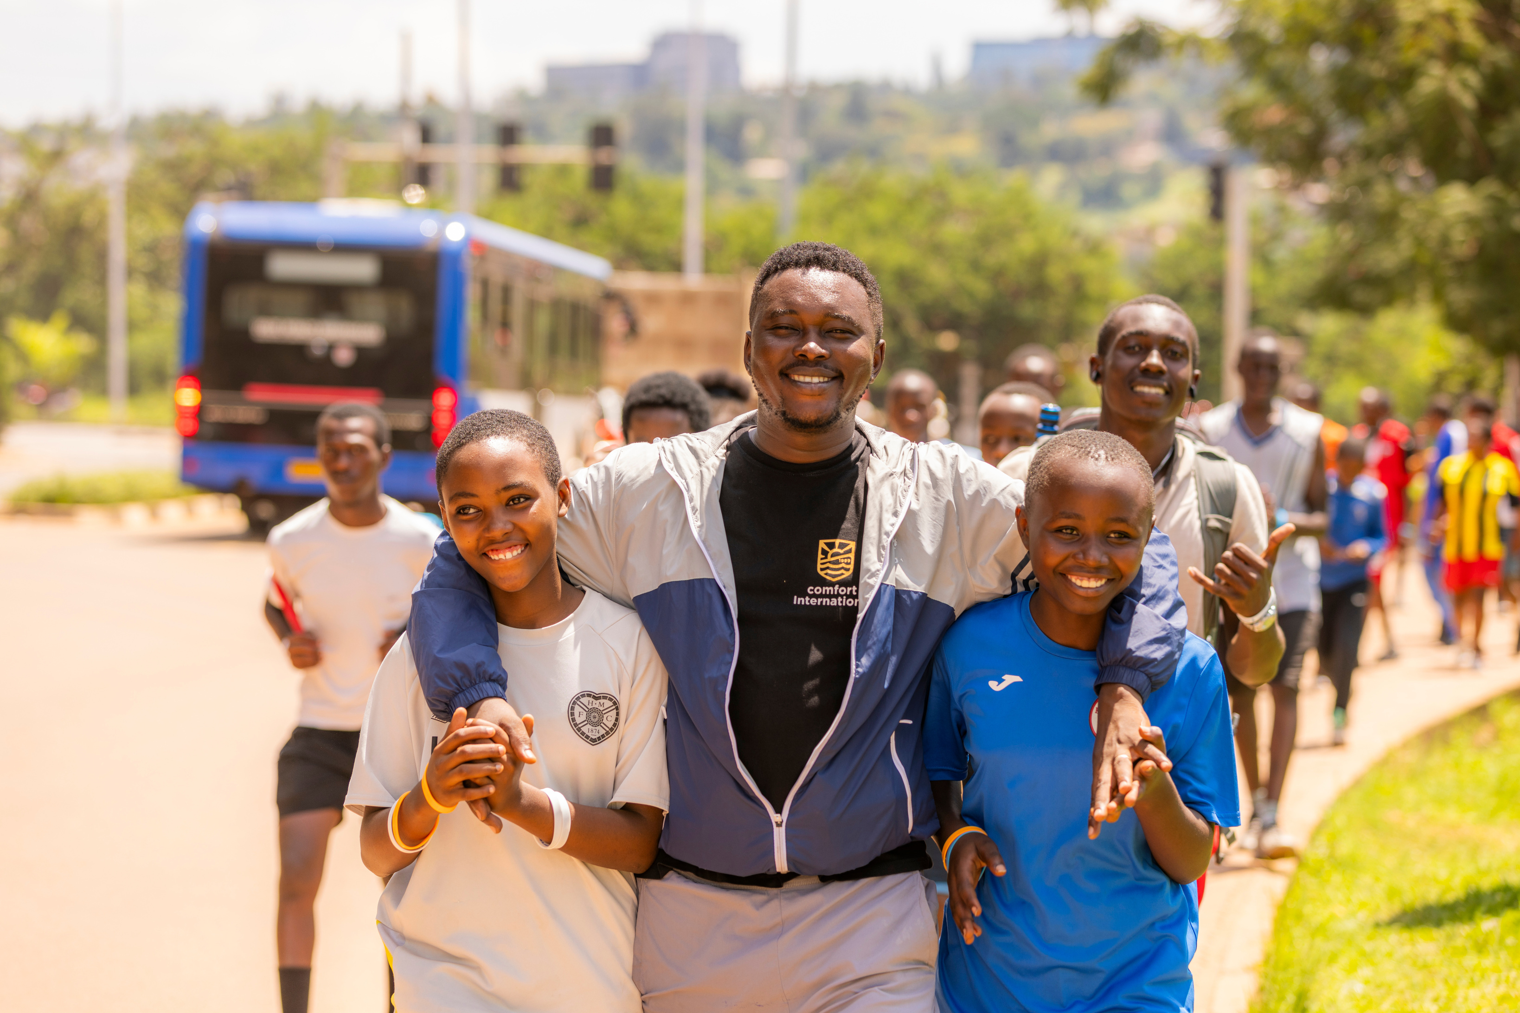
How many people live in Rwanda?
A. 3 million
B. 13 million
C. 30 million
D. 100 million

Slide 5
B. 13 million

Slide 6
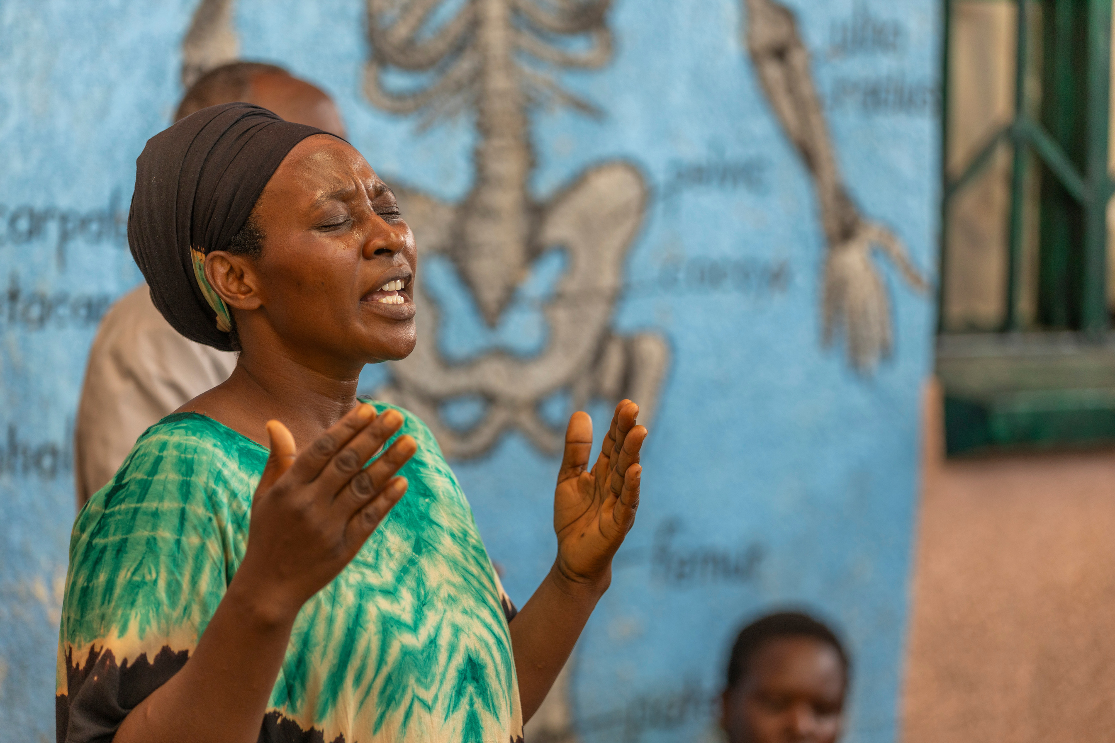
What is the official language of Rwanda?
A. English
B. French
C. Swahili
D. Kinyarwanda

Slide 7
D - Kinyarwanda
However many people also speak English, French and Swahili

Slide 8
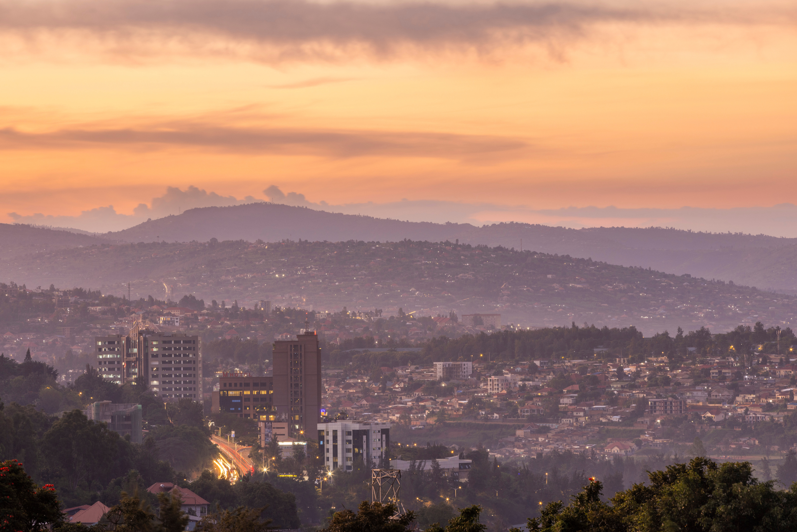
What is the capital of Rwanda?
A. Kampala
B. Kigali
C. Bujumbura
D. Kinshasa

Slide 9
B - Kigali
See if you can name the other countries whose capital’s are named here - all countries that Comfort International works in!
Notes:
A - Kampala = Uganda
B - Kigali = Rwanda
C - Bujumbura = Burundi
D - Kinshasa = Democratic Republic of Congo

Slide 10
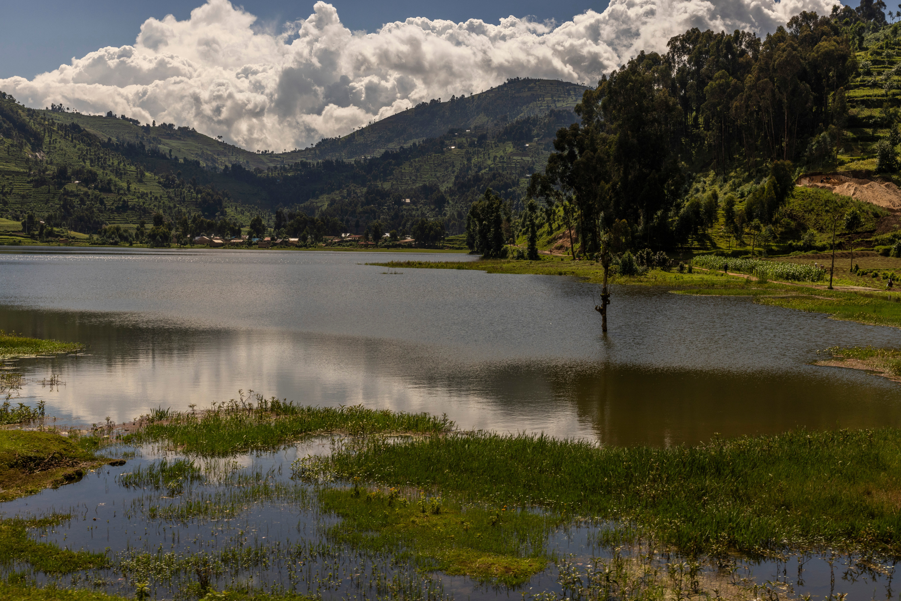
Which of these is banned in Rwanda?
A. Plastic bags
B. Alcohol
C. Diesel cars
D. Football

Slide 11
A. Plastic bags

Slide 12
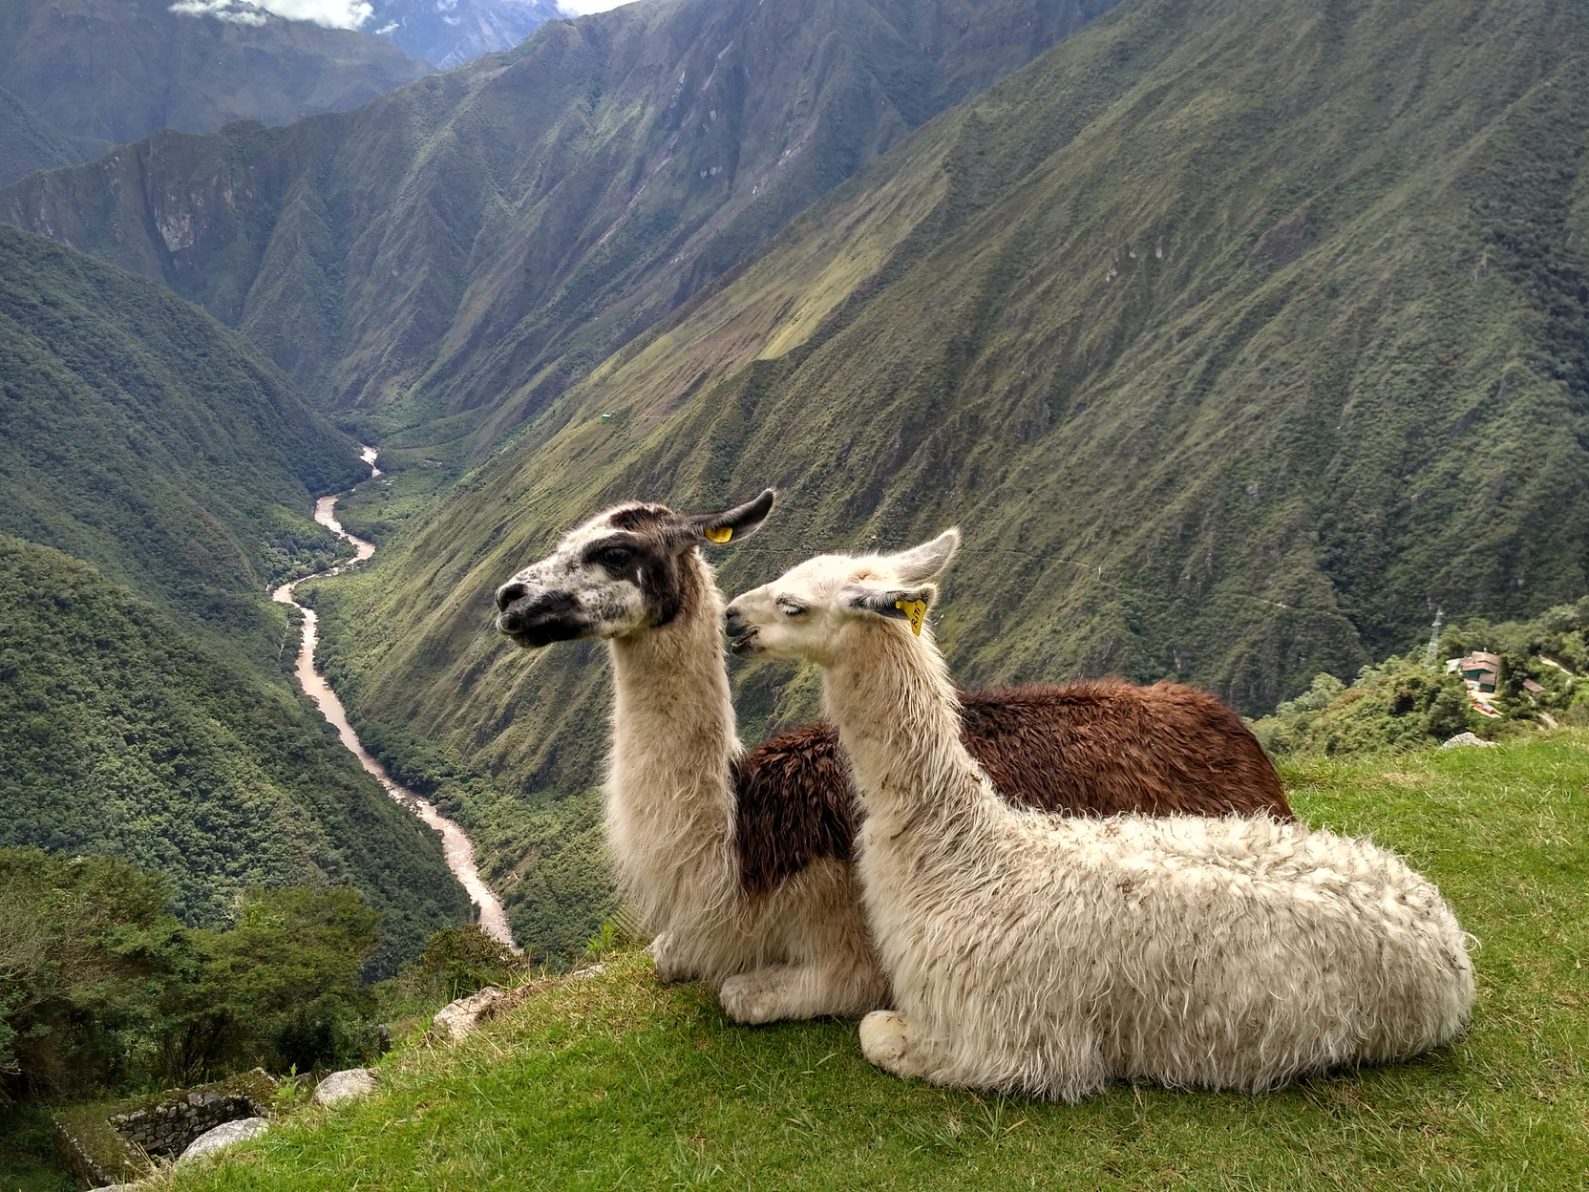
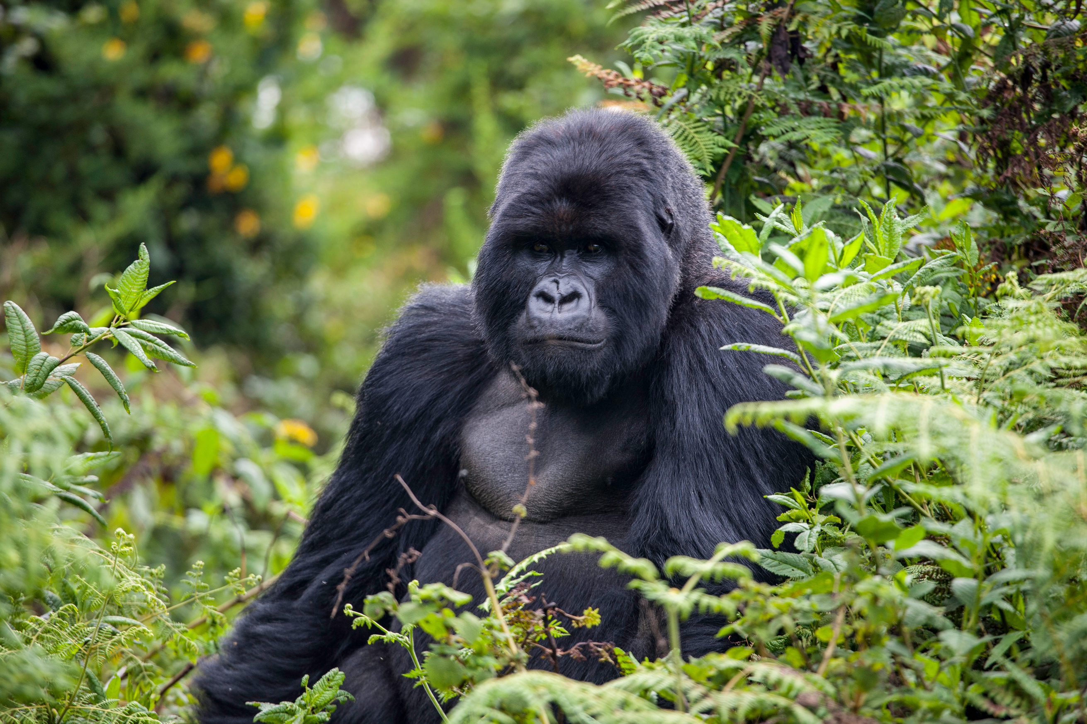
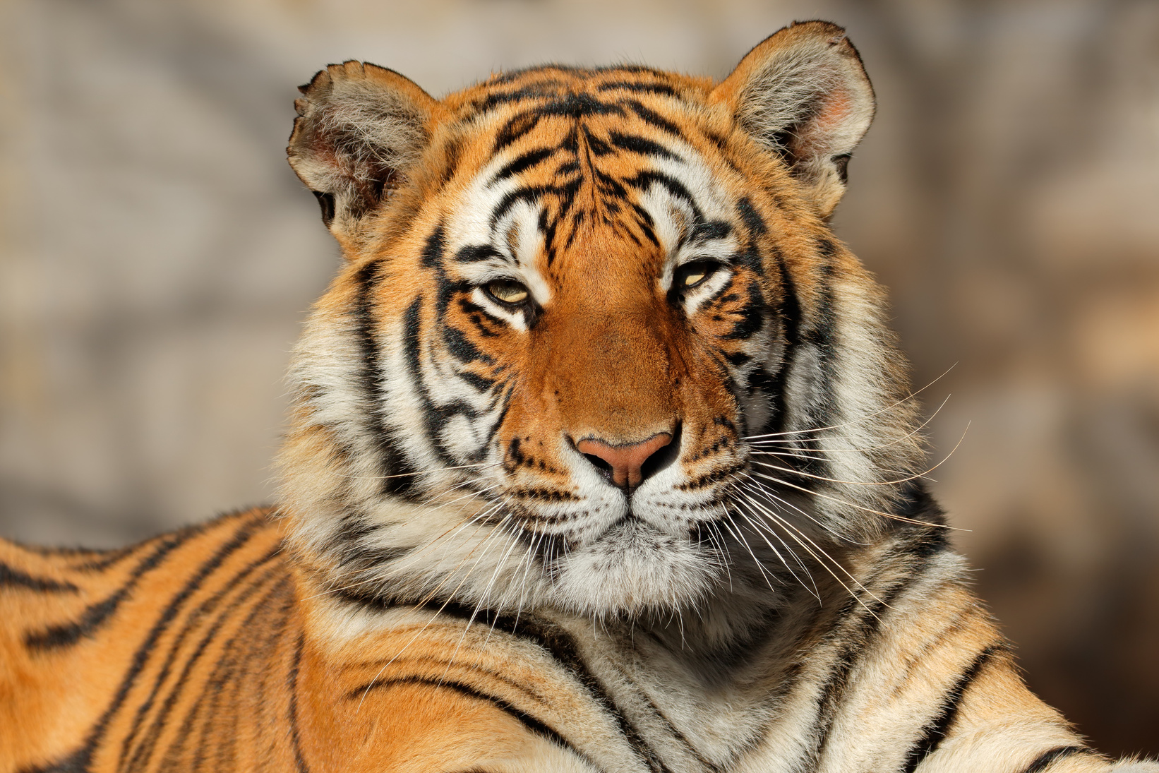
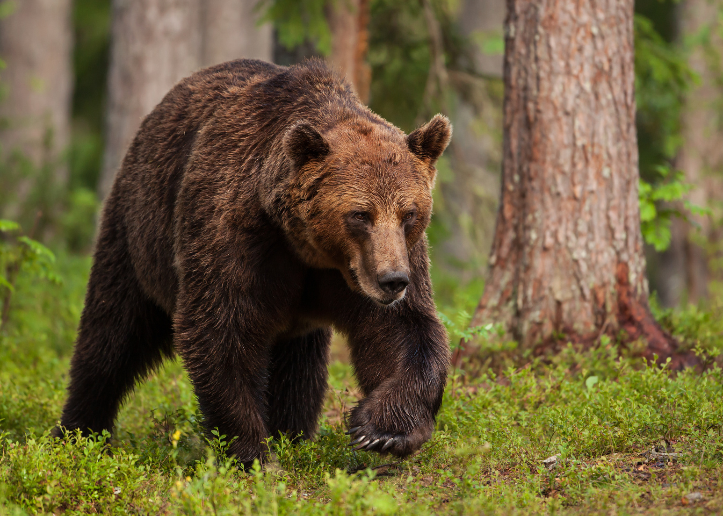
What animals can you find in Rwanda?
A. Alpacas
B. Mountain Gorillas
C. Tigers
D. Brown bears

Slide 13
B. Mountain Gorillas
Rwanda is home to the last remaining mountain gorillas in the world. You can also find elephants, giraffes, antelope, lions, rhino, hippos and many more animals!

Slide 14
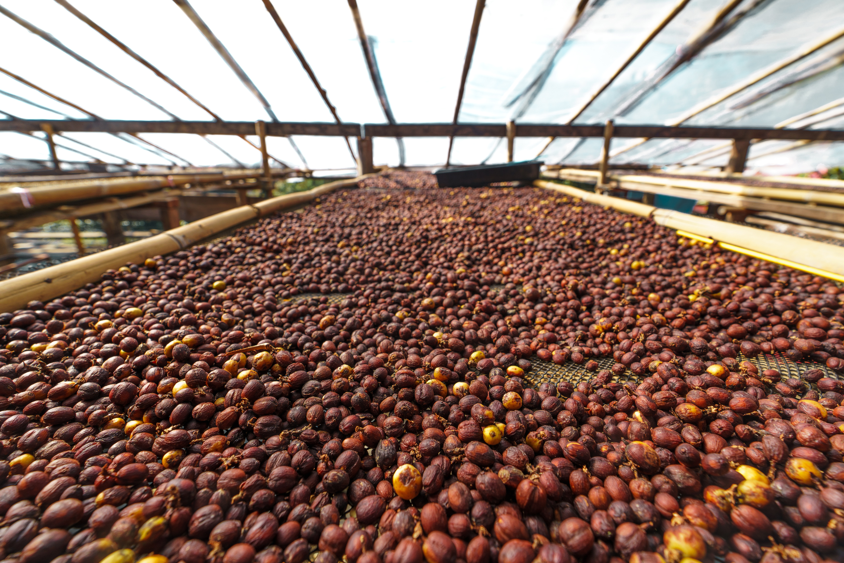
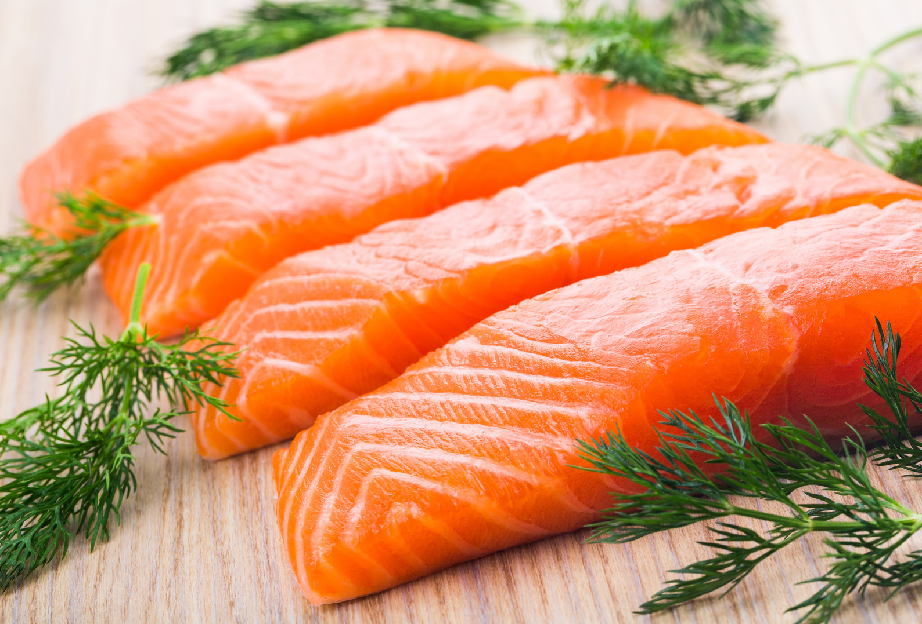
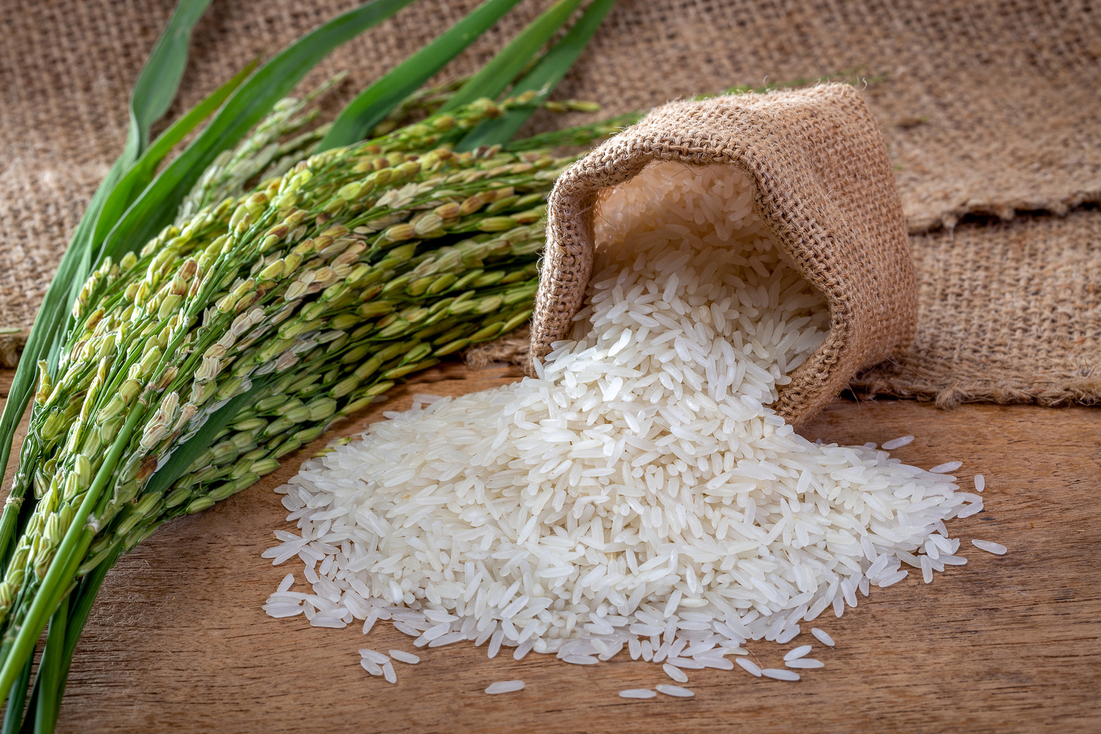
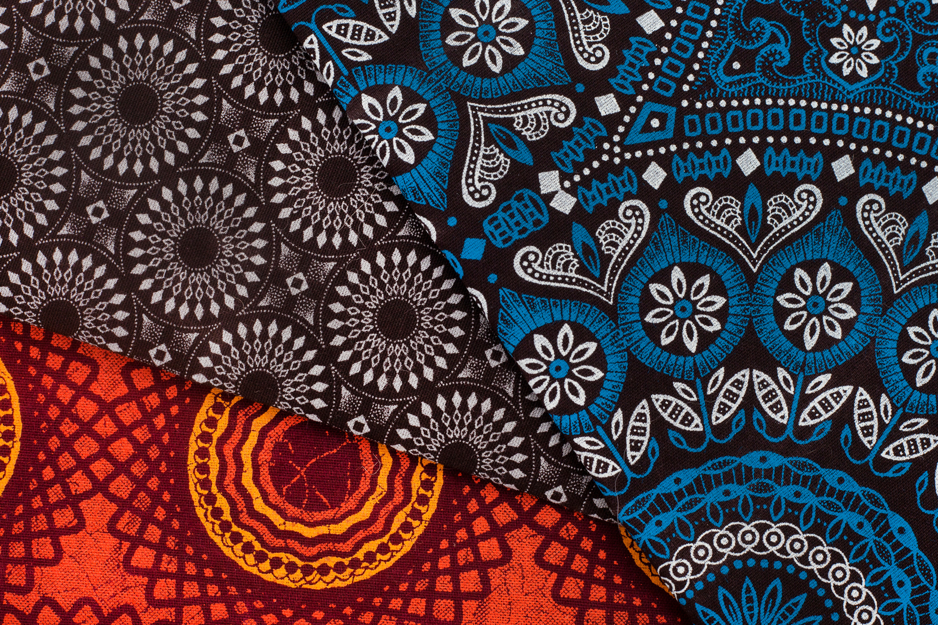
What is Rwanda’s biggest export?
A. Coffee
B. Salmon
C. Rice
D. Fabric

Slide 15
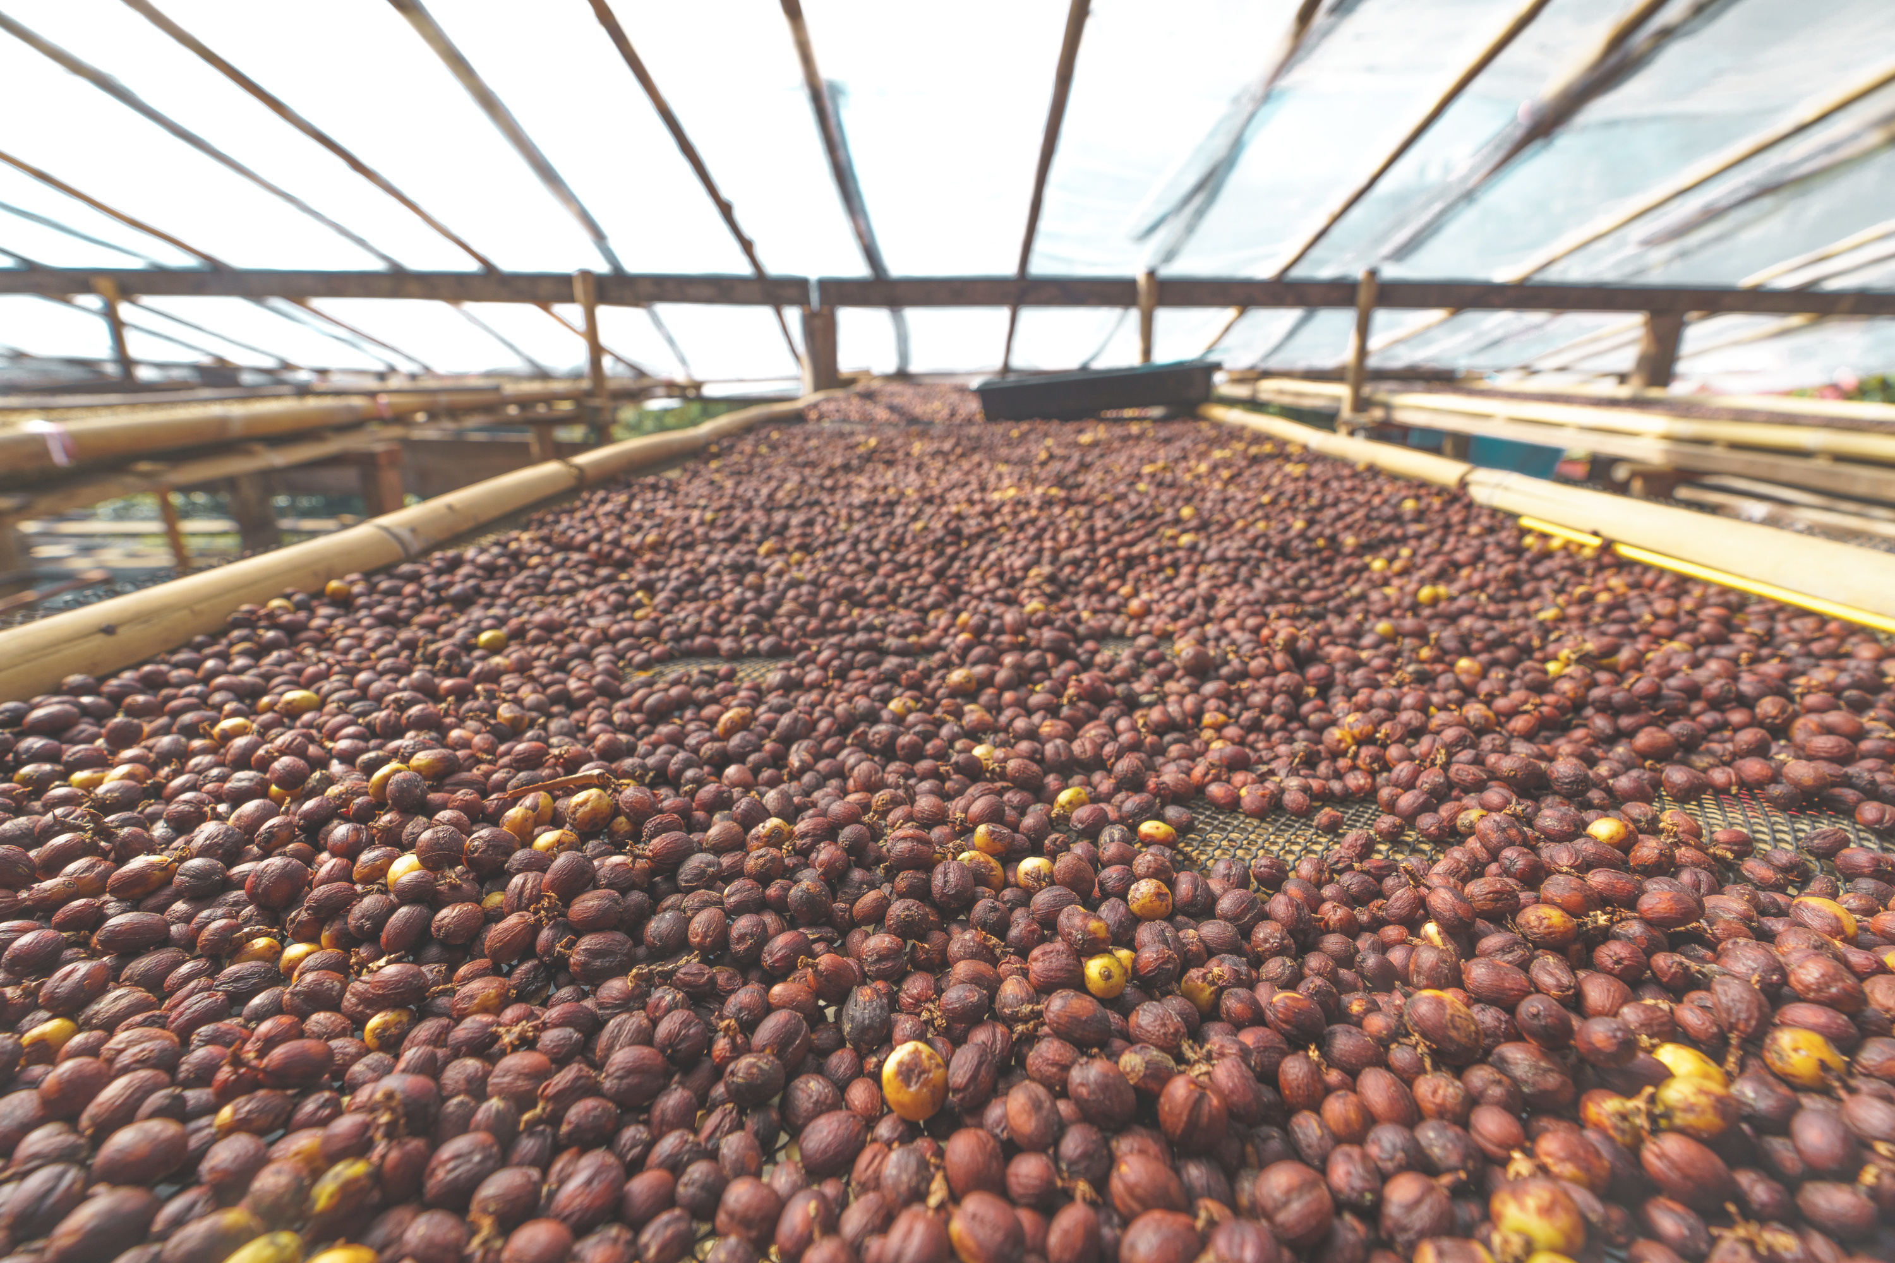
A. Coffee

Slide 16
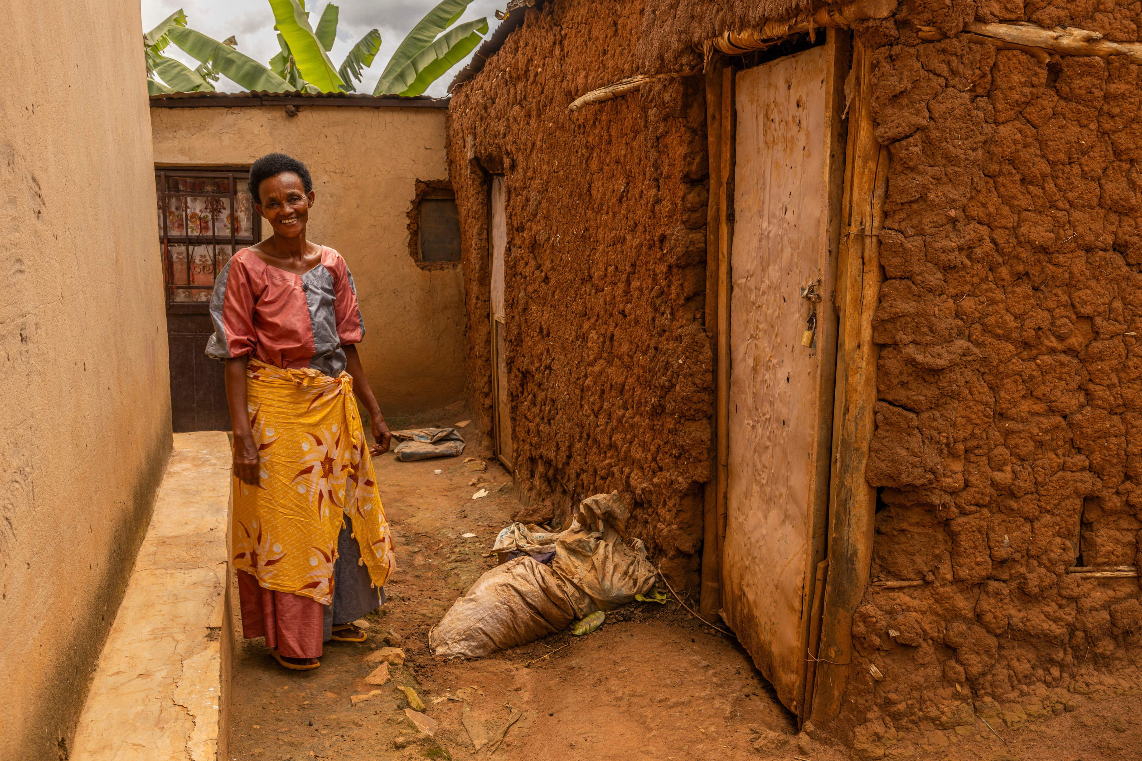
What is the currency in Rwanda?
A. Rwandan Francs
B. US Dollars
C. Pound Sterling
D. Rwandan Pesos

Slide 17
A. Rwandan francs

Slide 18
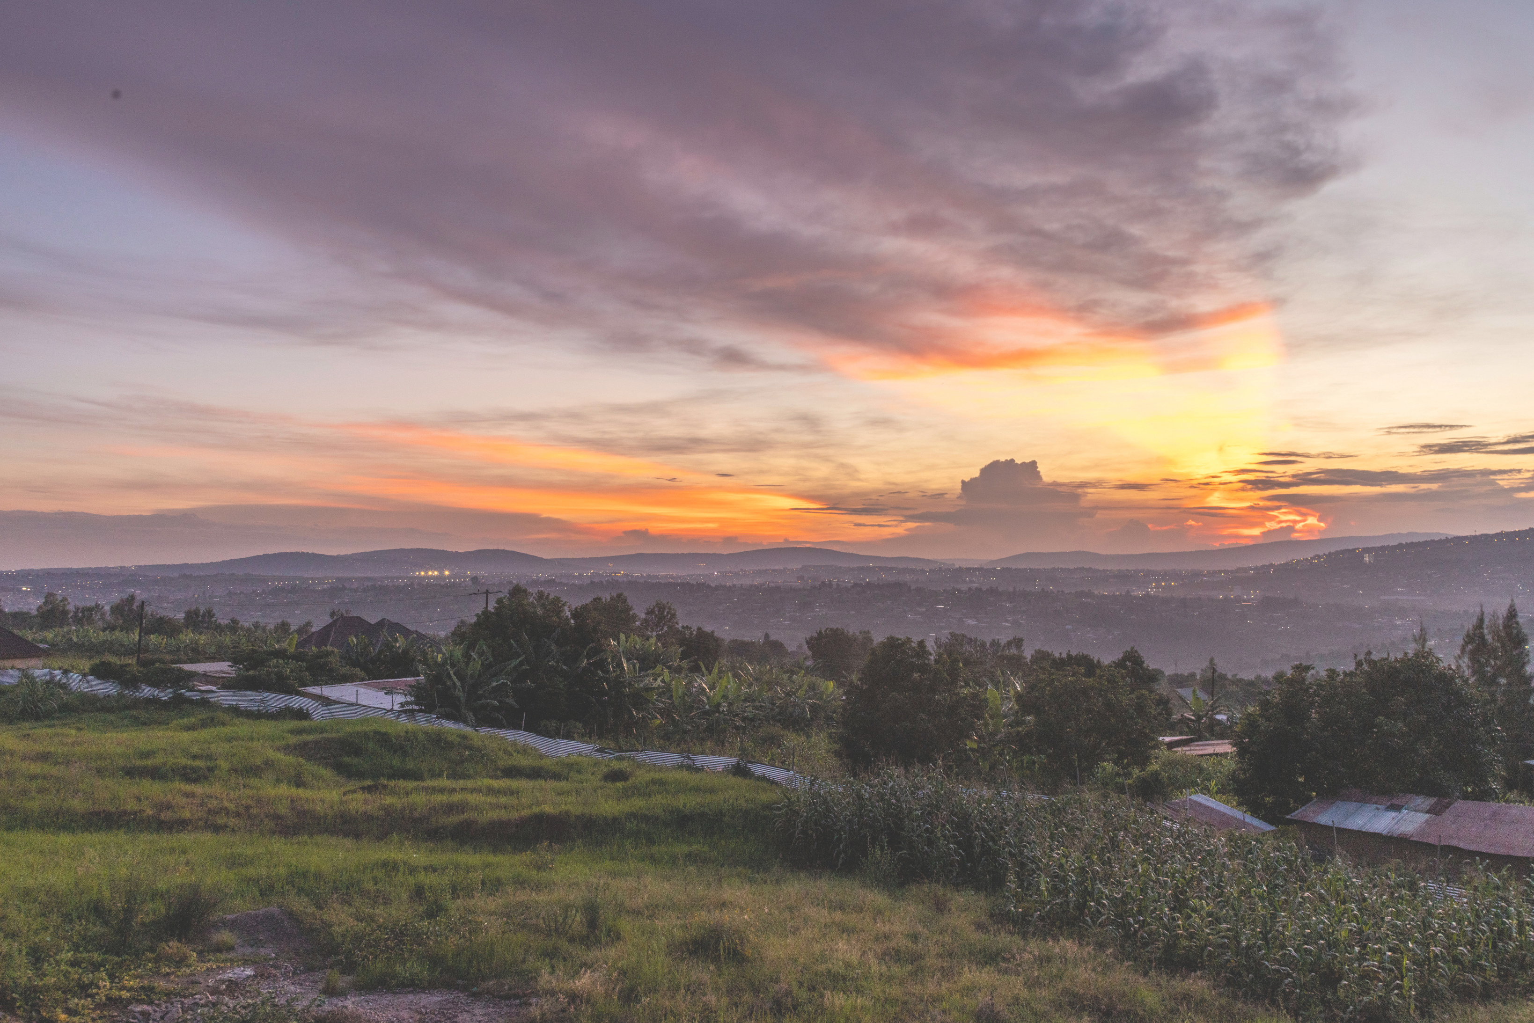
Rwanda is known as the ...
A. Land of a thousand elephants
B. Land of a thousand people
C. Land of a thousand hills
D. Land of a thousand years

Slide 19
C. Land of a thousand hills

Slide 20
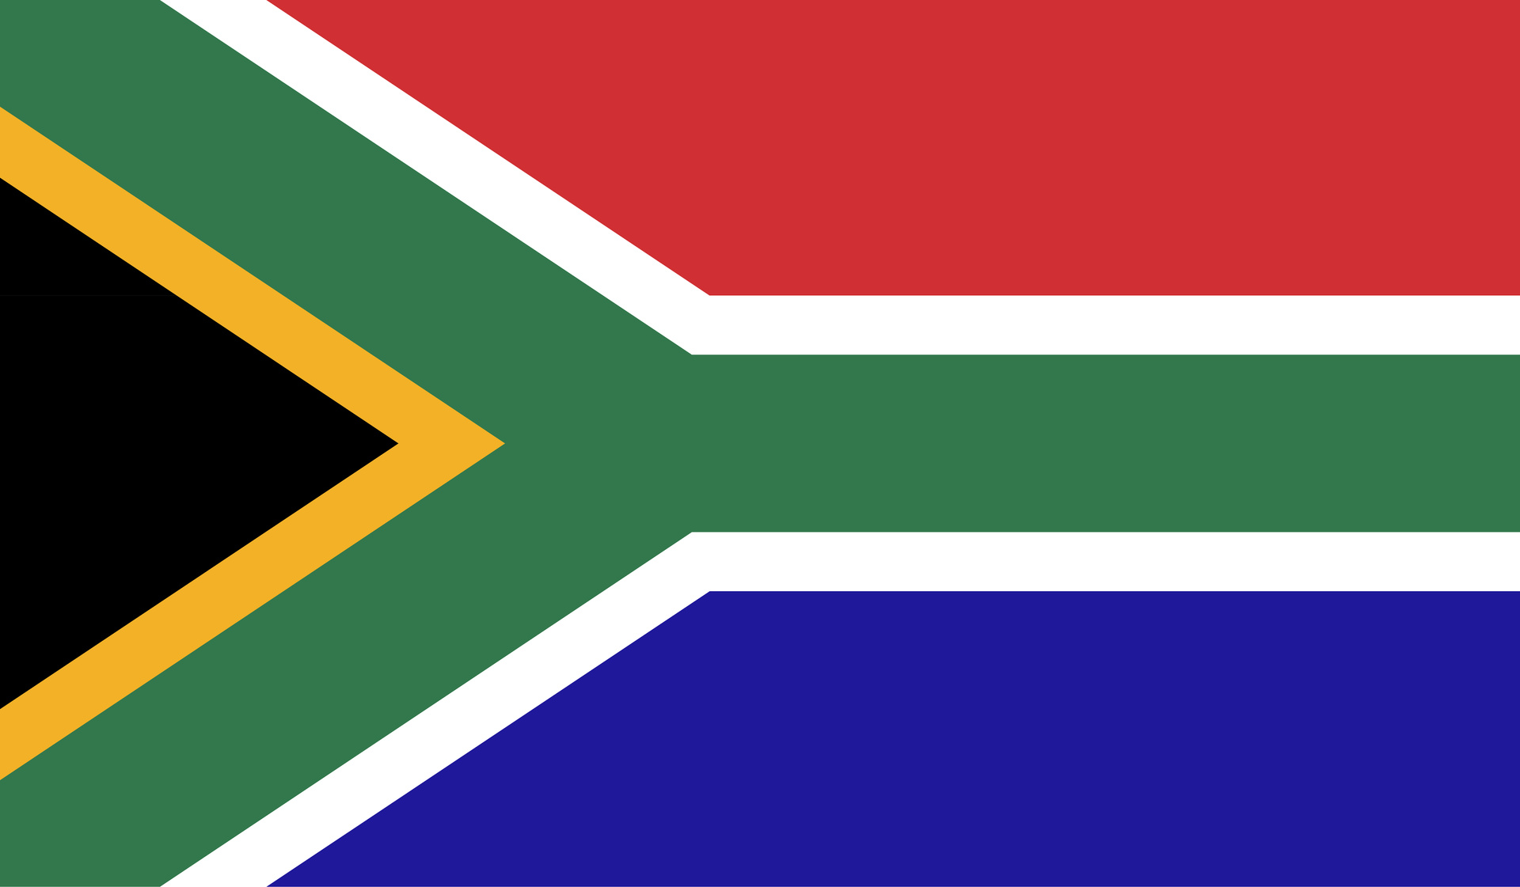
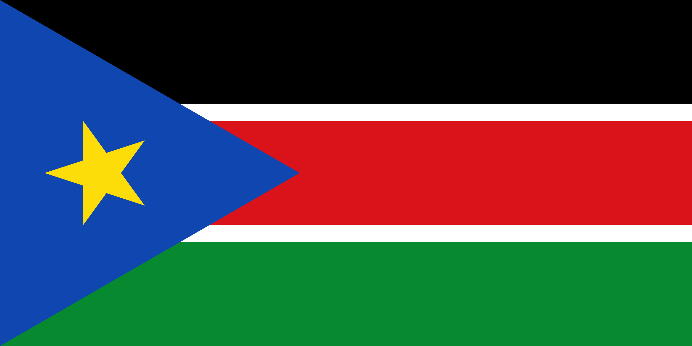


A.
B.
Which flag belongs to Rwanda?
C.
D.

Slide 21
D!
A = South Sudan
B = South Africa
C = Scotland

Slide 22

Murakoze cyane! Thanks for listening!
SCIO SC030369
comfortinternational.org

