Slide 1
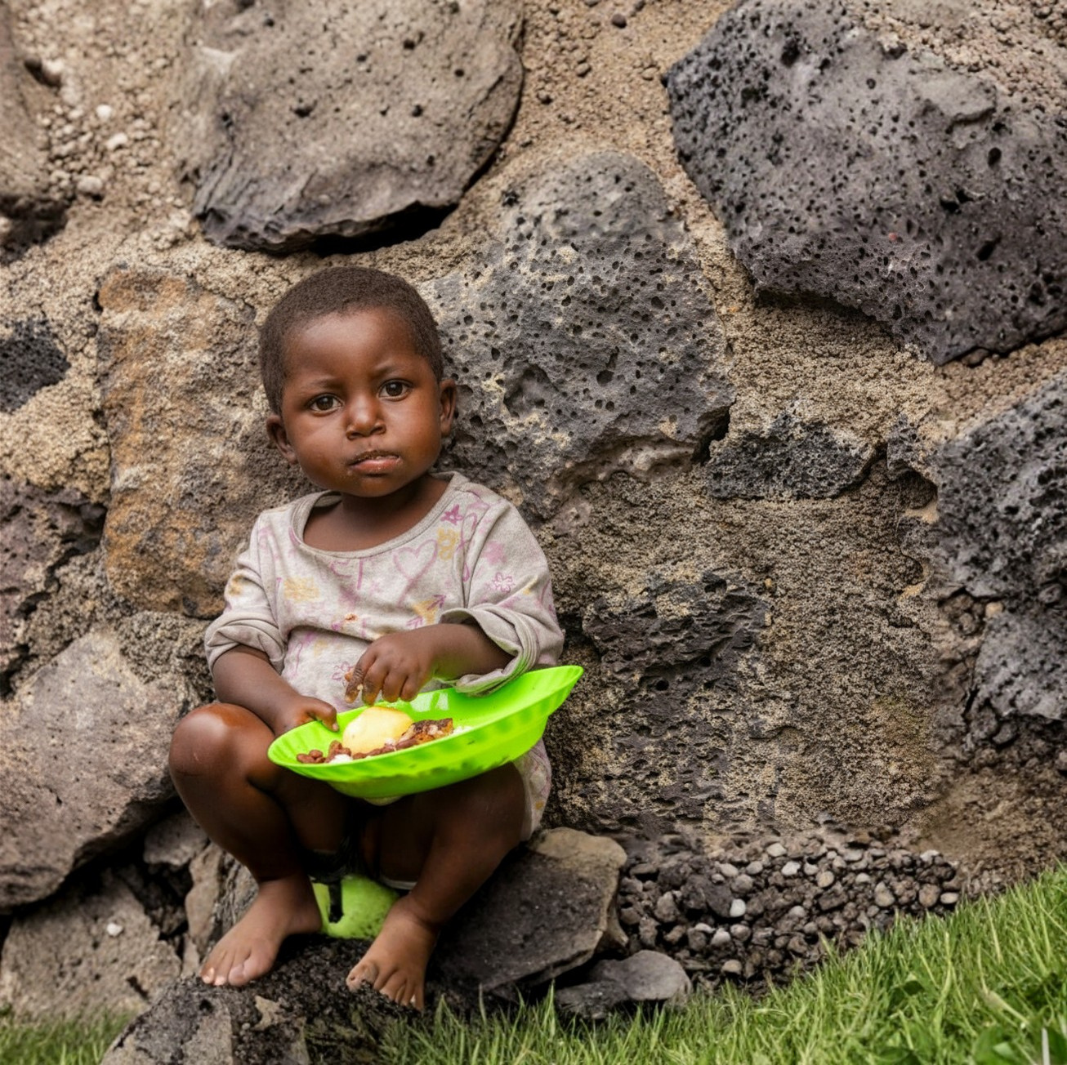


Congo Child
Feeding Project
Regular giving; Reliable meals;
Real change.

