Slide 1
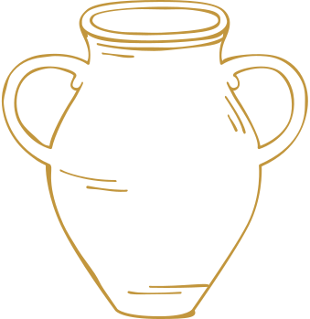


Harvest 2026
Quiz
SCIO SC030369
comfortinternational.org

Slide 2
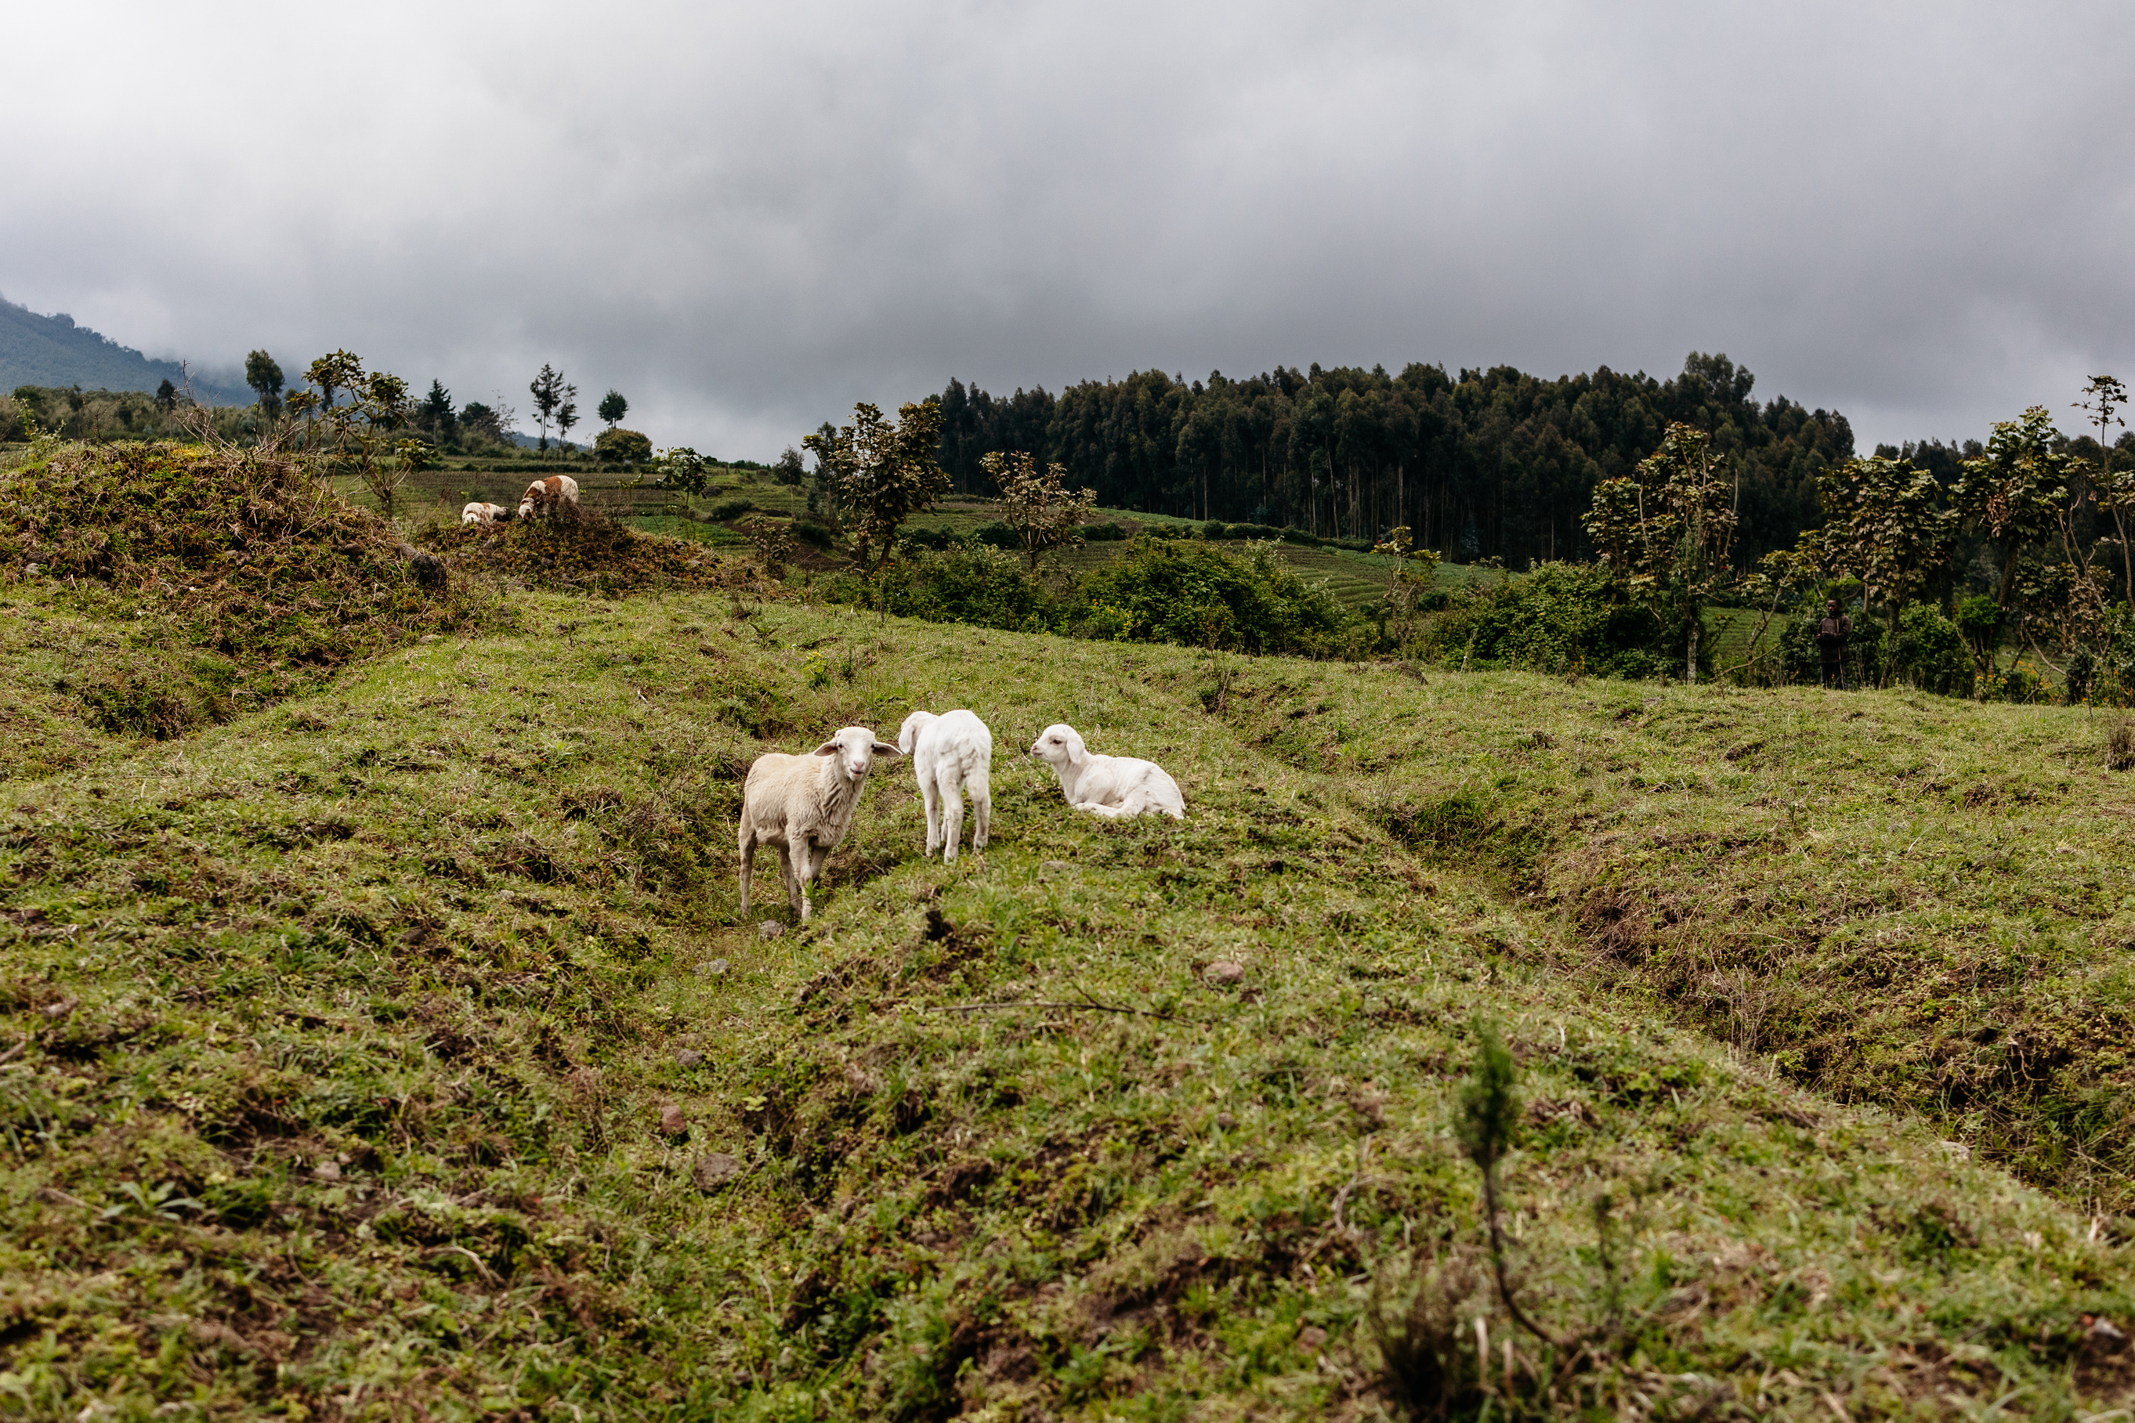
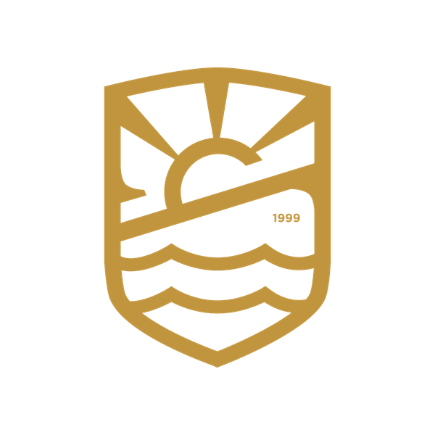
Ruth 2v8: “Stay right here with us when you gather grain; don’t go to any other fields. Stay right behind the young women working in my field.”
Ephesians 1v7: “He is so rich in kindness and grace that he purchased our freedom with the blood of his Son and forgave our sins.”
NLT

Slide 3
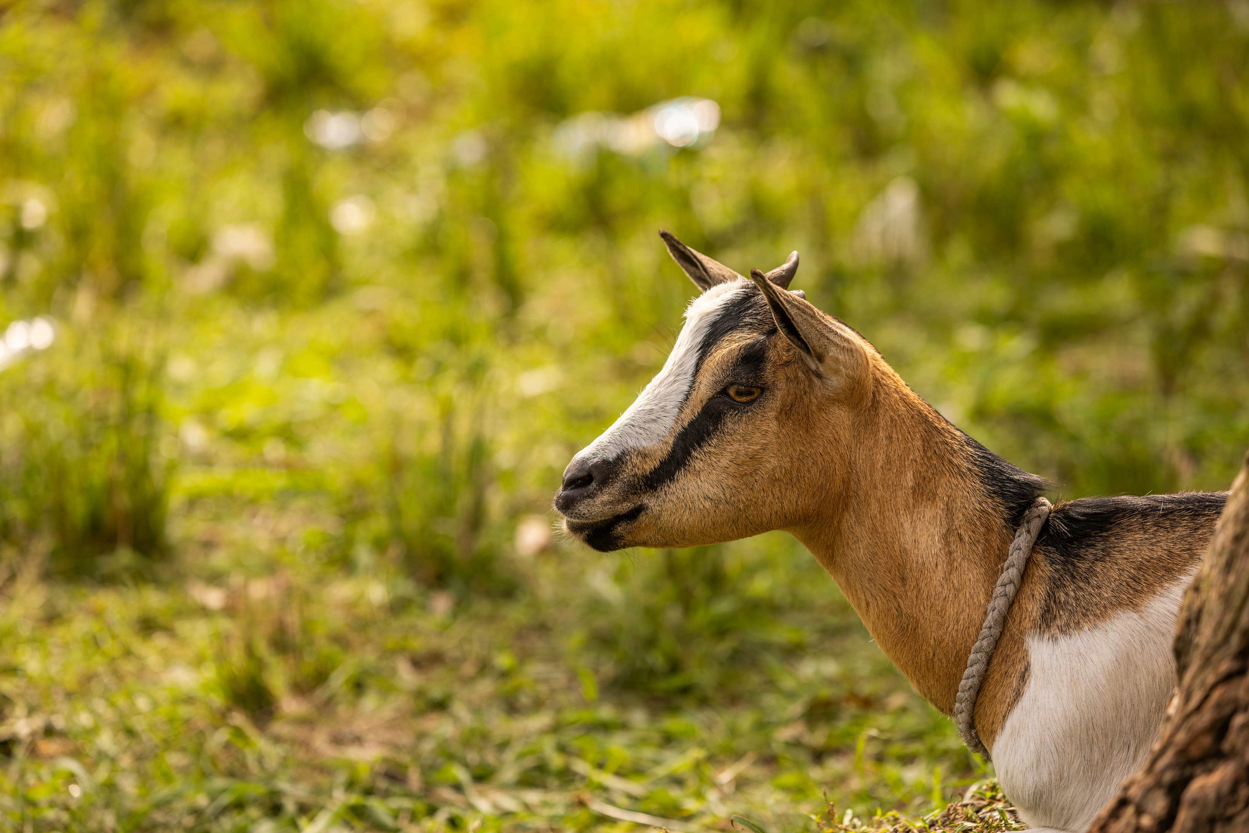
Democratic Republic of Congo Quiz

Slide 4
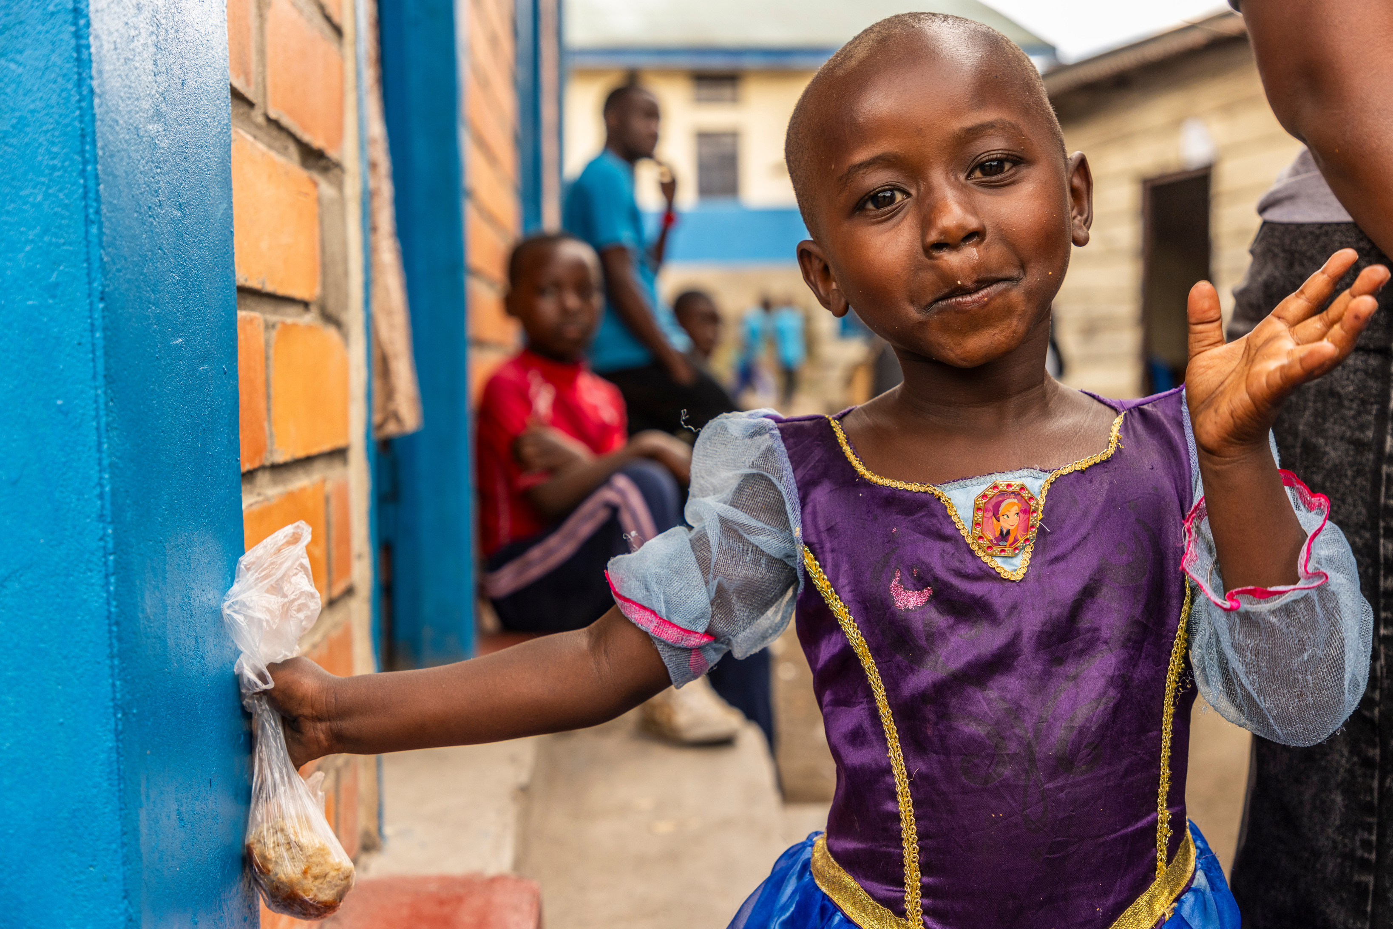
How many people live in DRC?
A. 1,100,000
B. 11,000,000
C. 110,000,000
D. 1,110,000,000

Slide 5
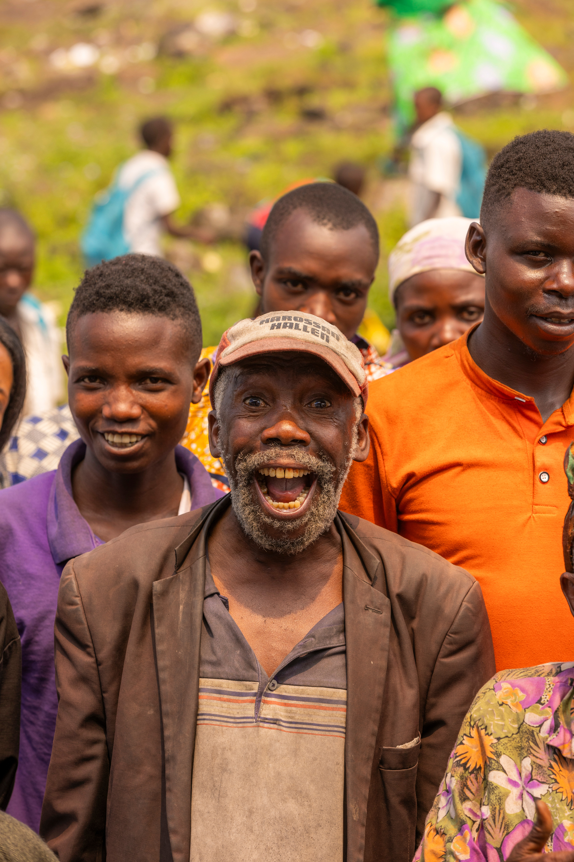
How many languages are spoken in DRC?
A. 1
B. 3
C. 50
D. 200

Slide 6
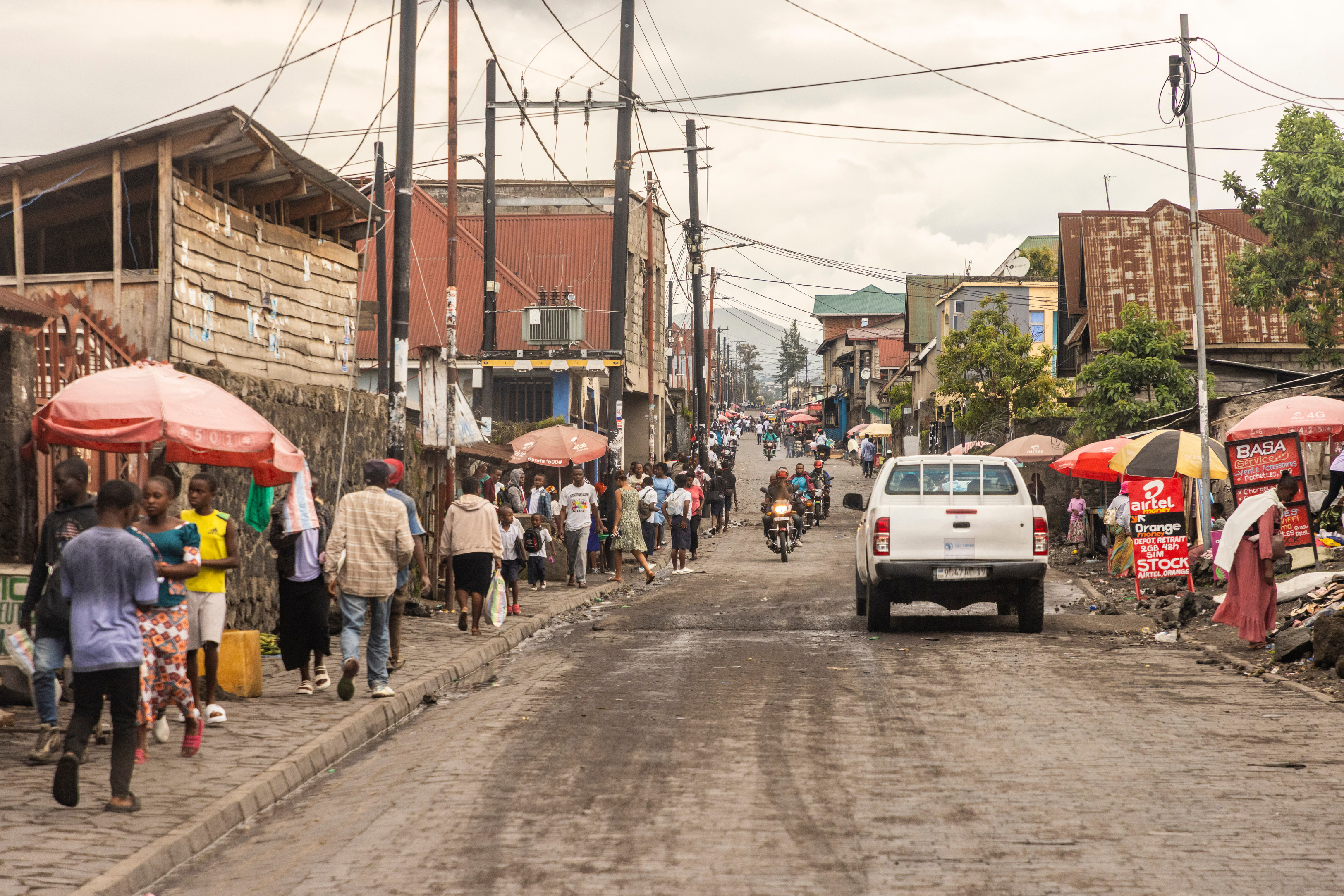
What is the capital of DRC?
A. Kampala
B. Kigali
C. Bujumbura
D. Kinshasa

Slide 7
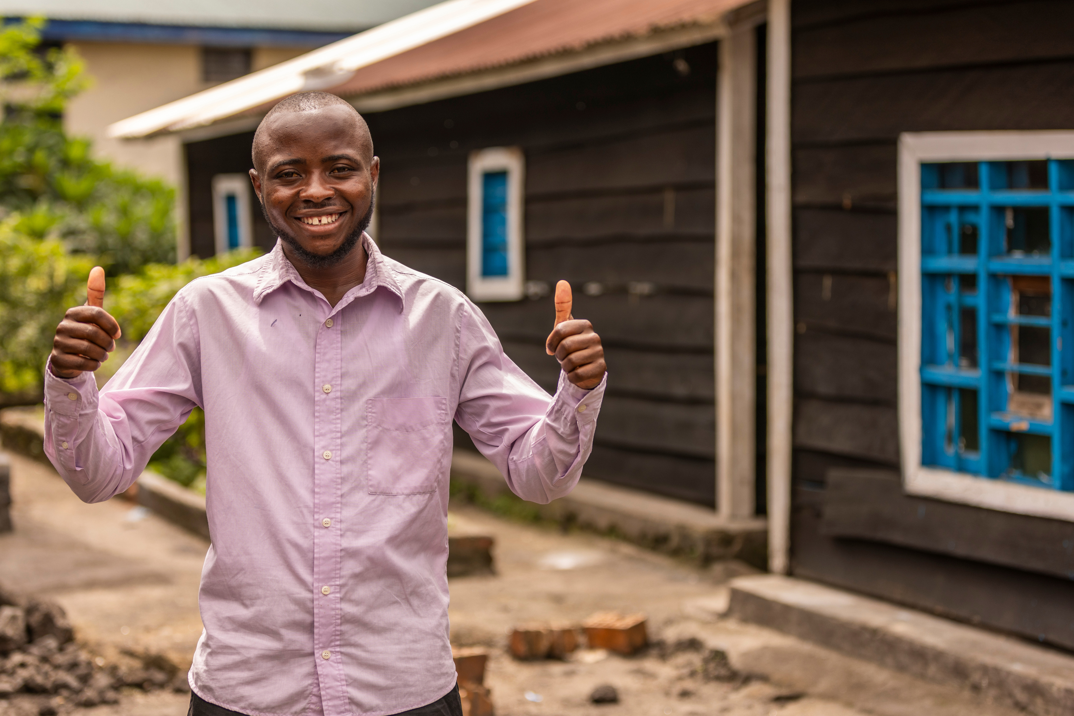
What is the most popular sport in DRC?
A. Football
B. Basketball
C. Rugby
D. Horse-riding

Slide 8
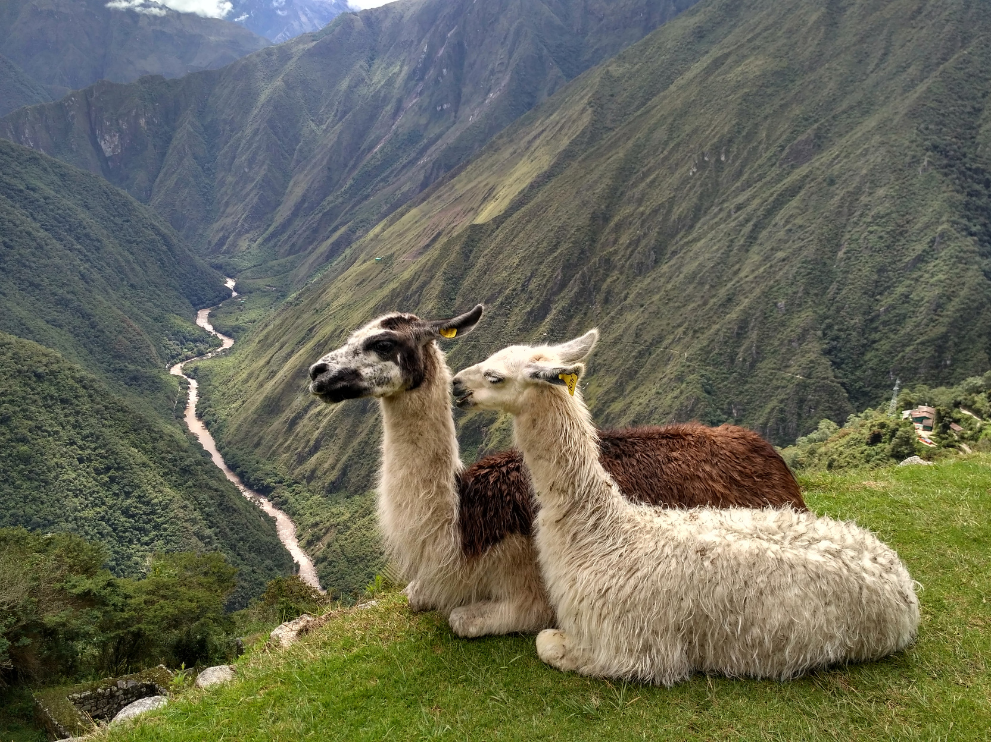
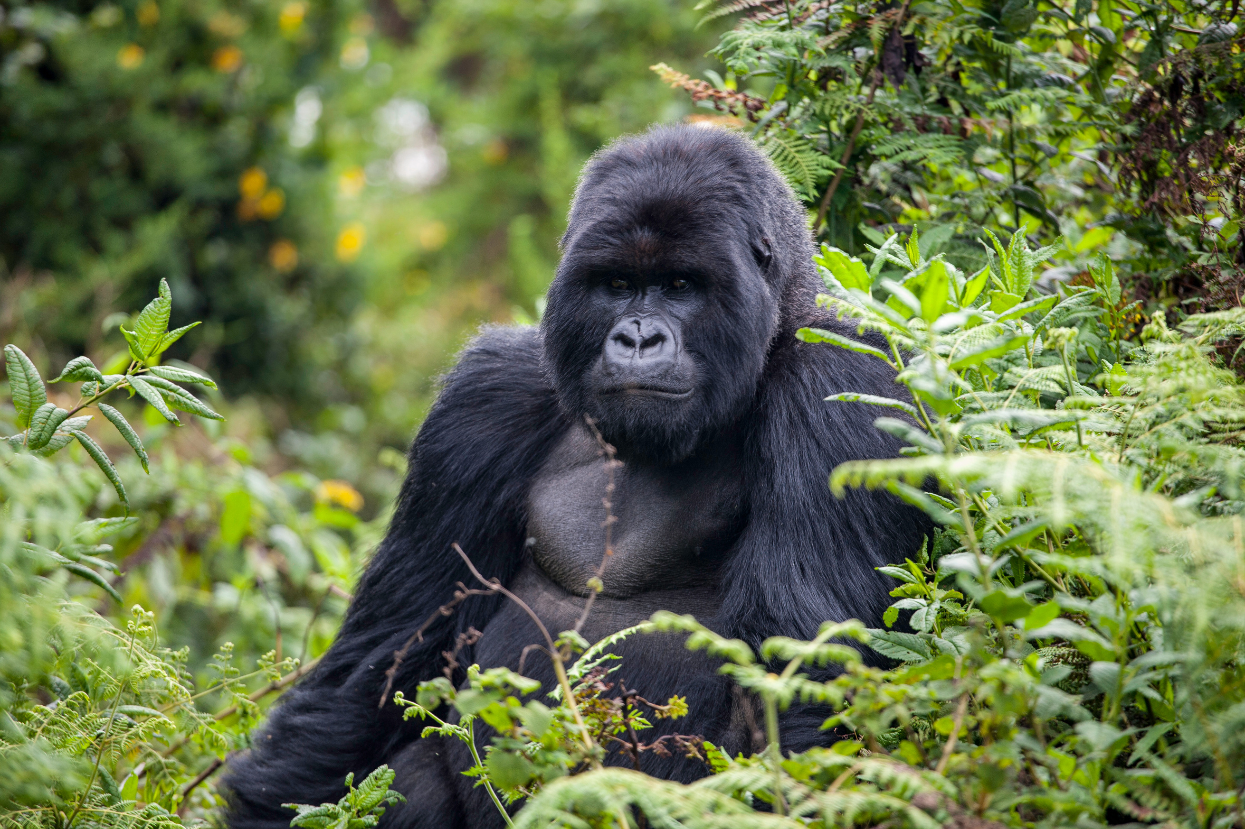
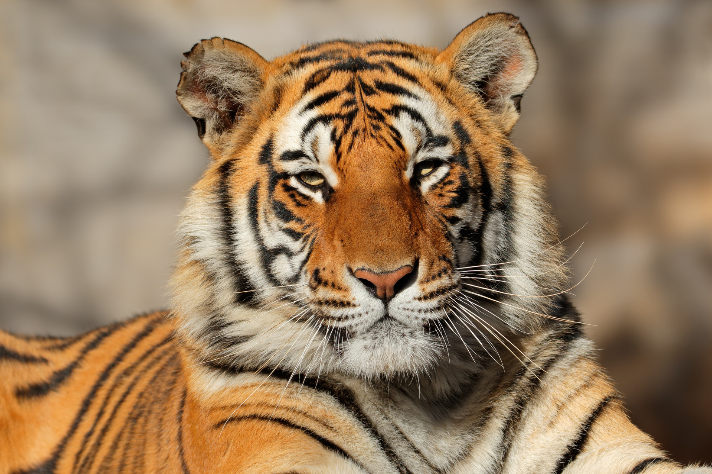
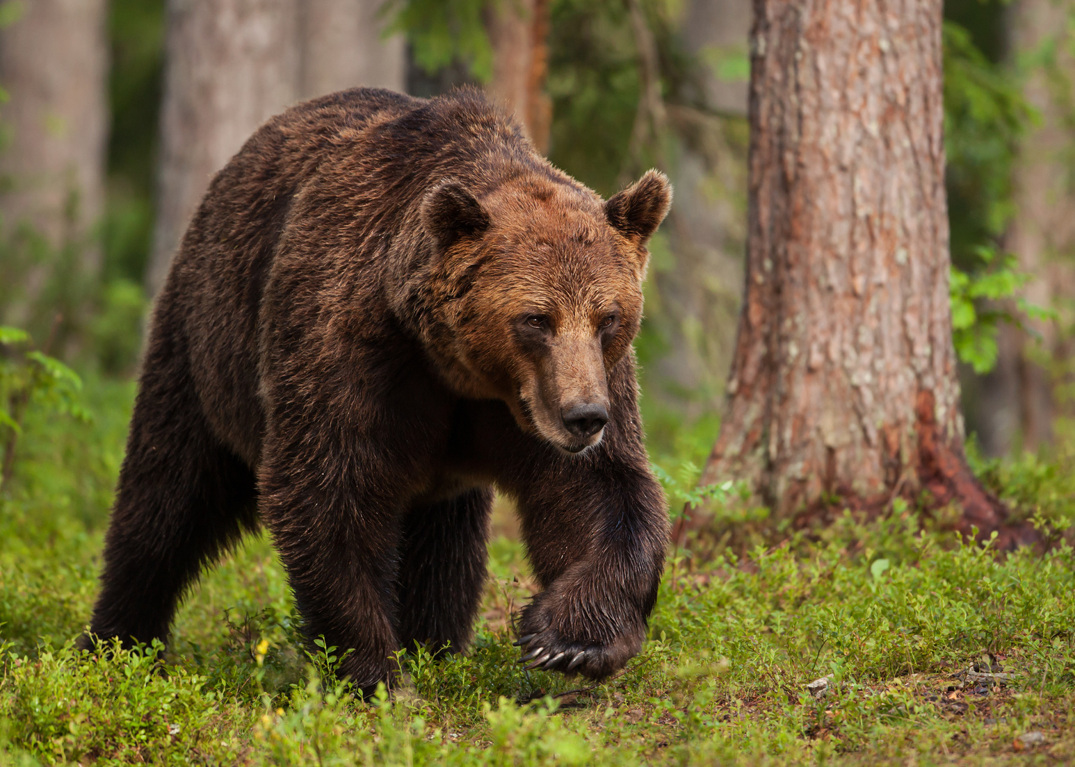
What animals can you find in DRC?
A. Alpacas
B. Mountain Gorillas
C. Tigers
D. Brown bears

Slide 9
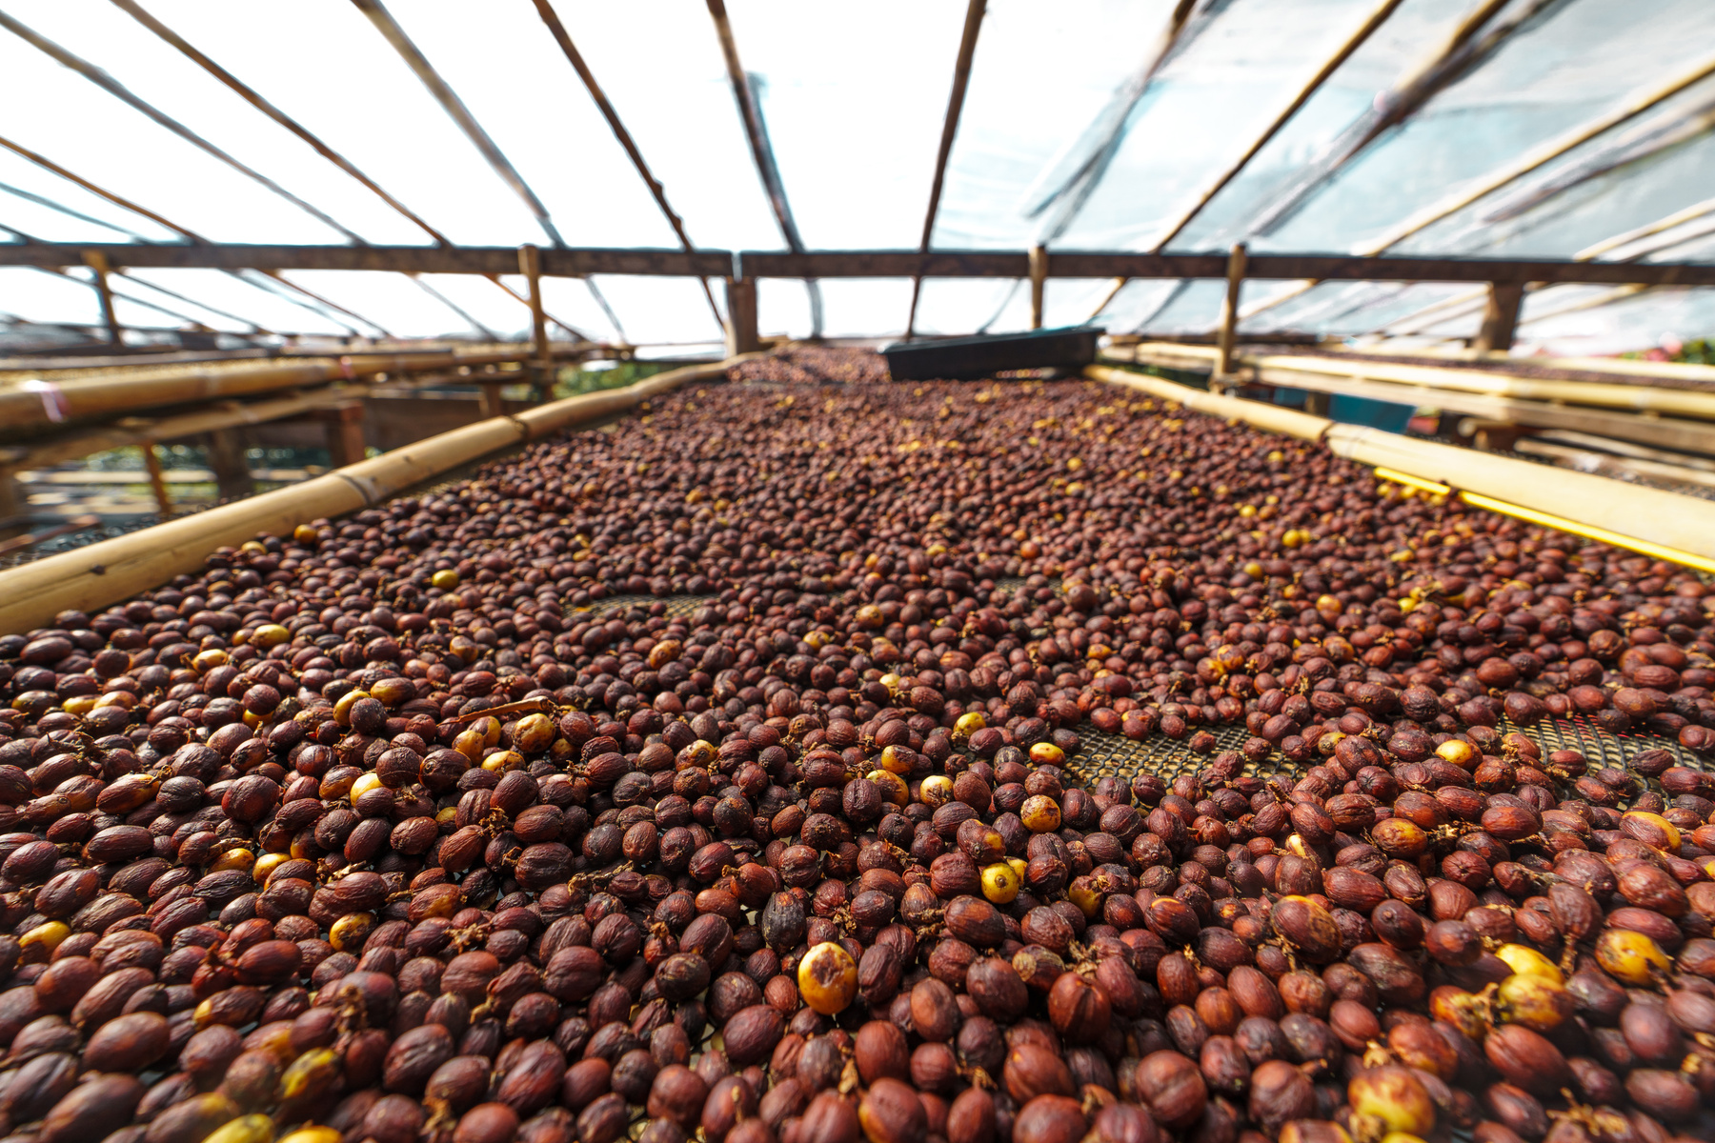
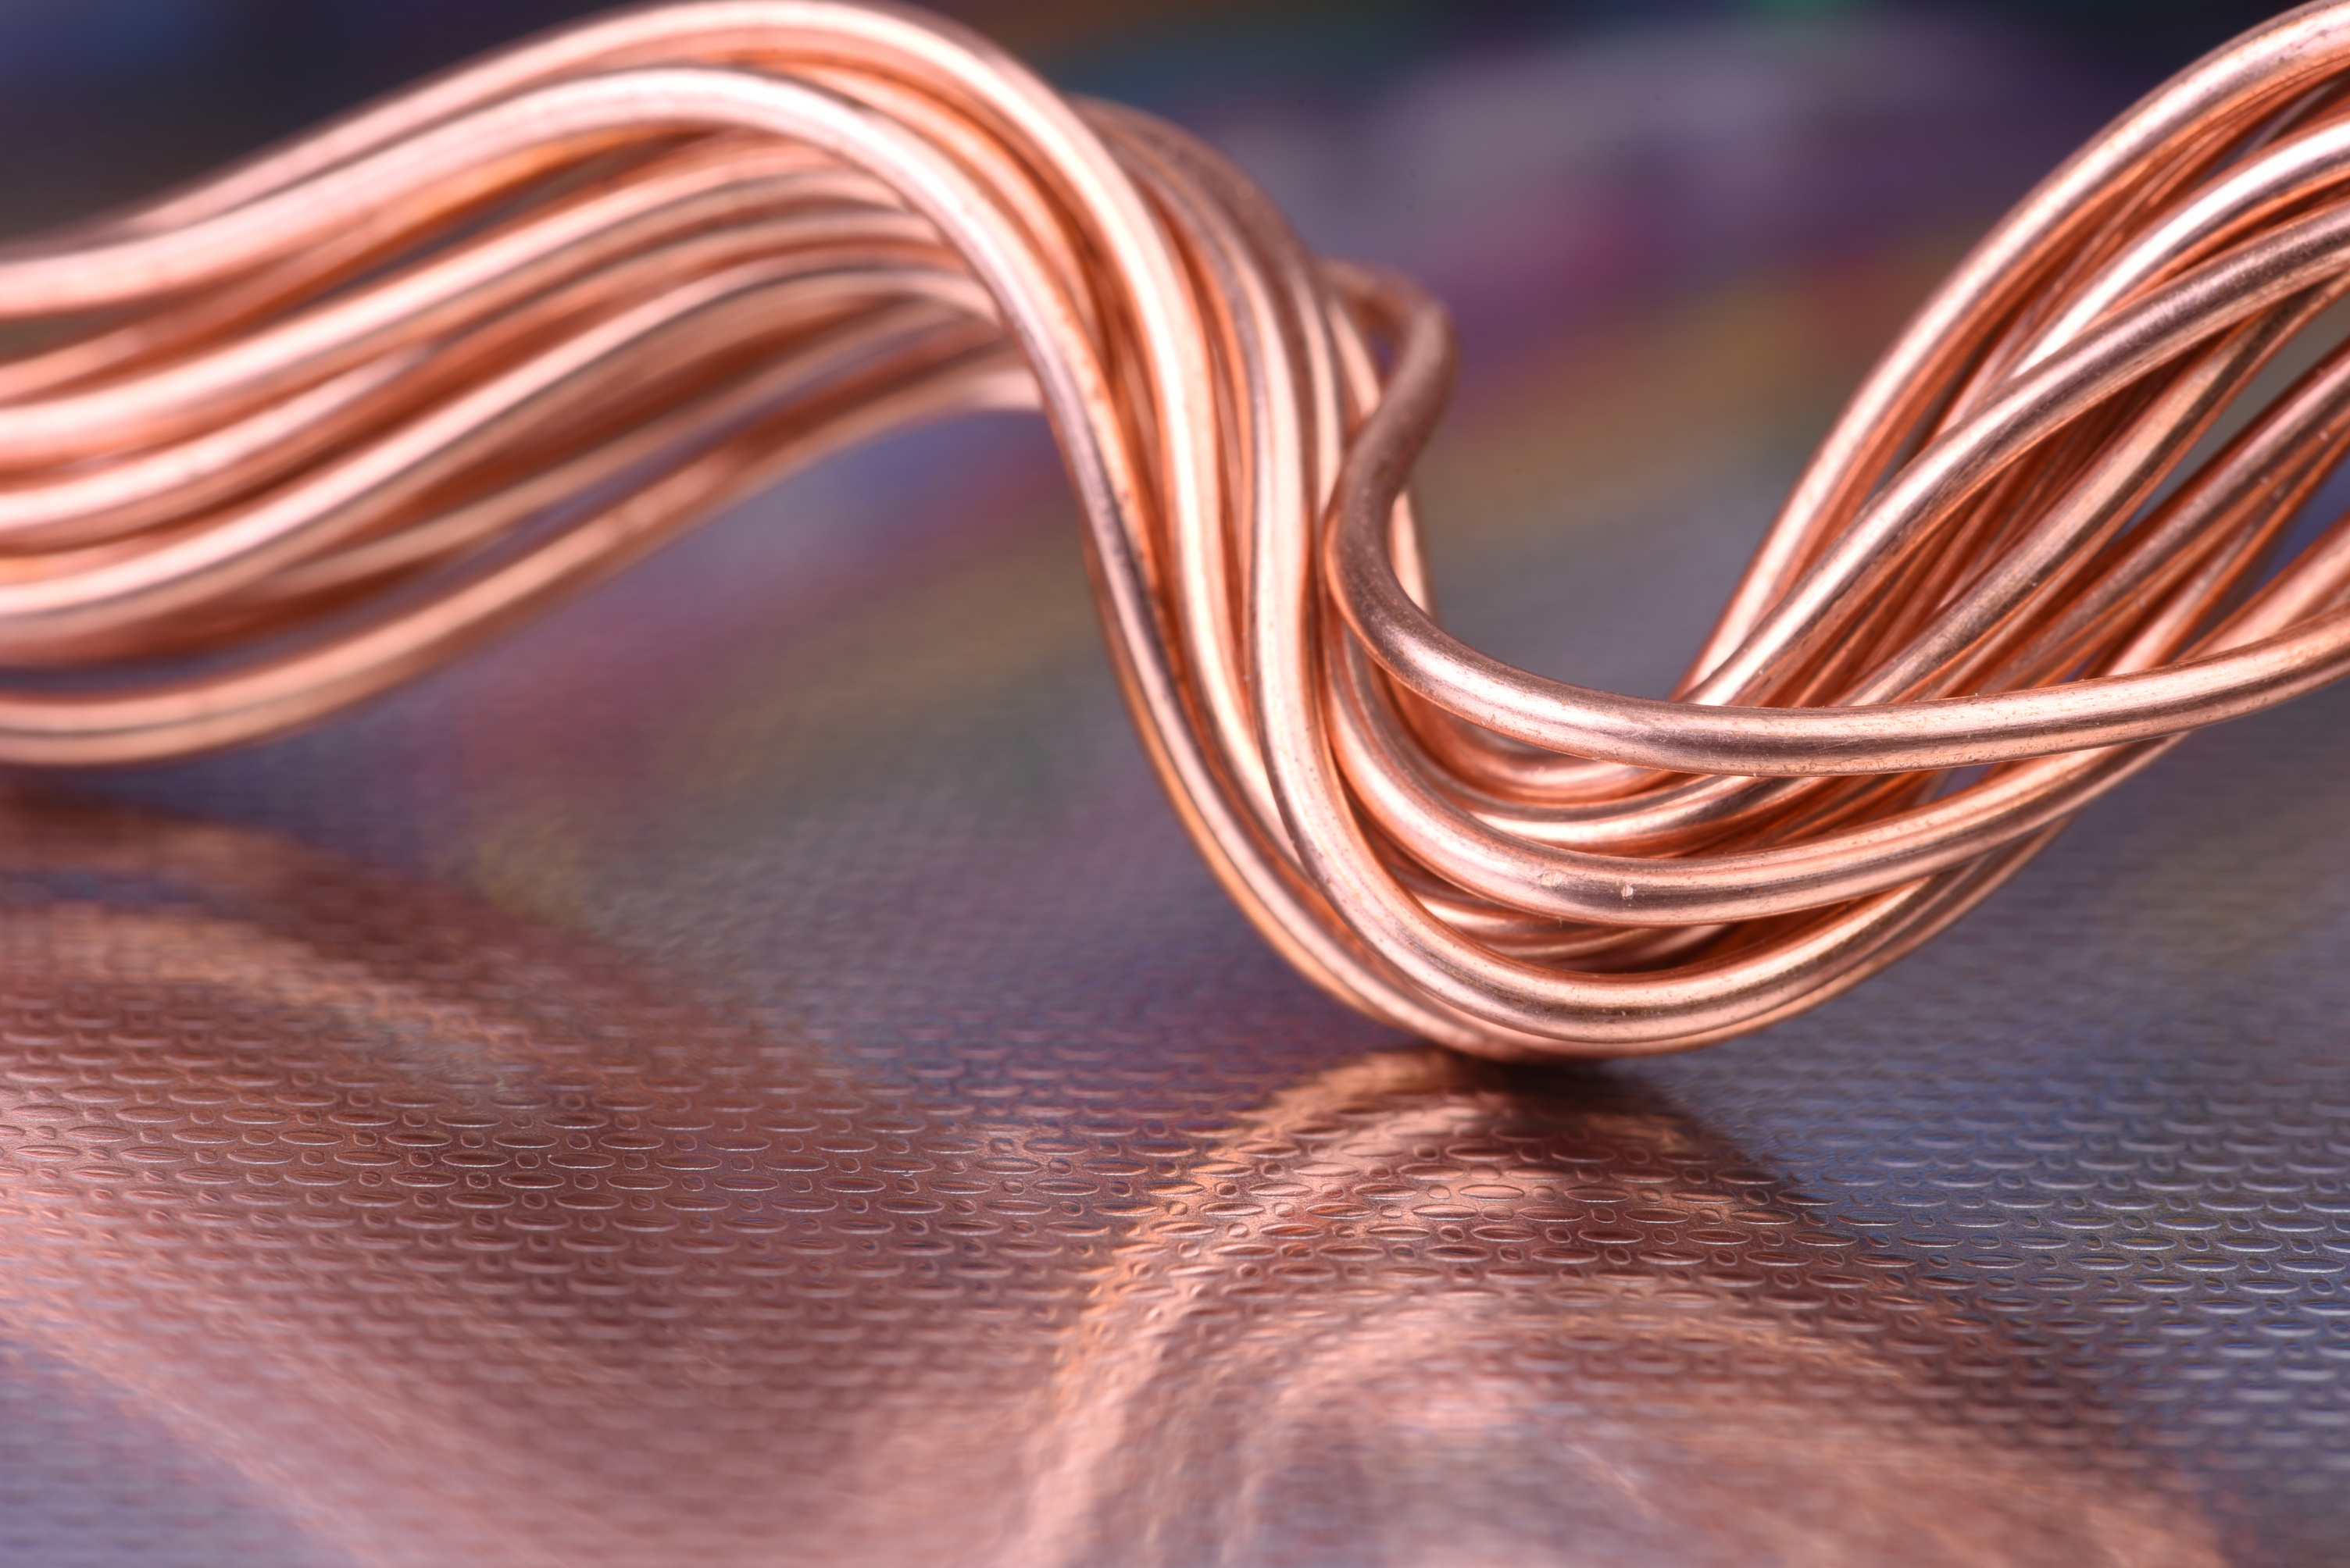
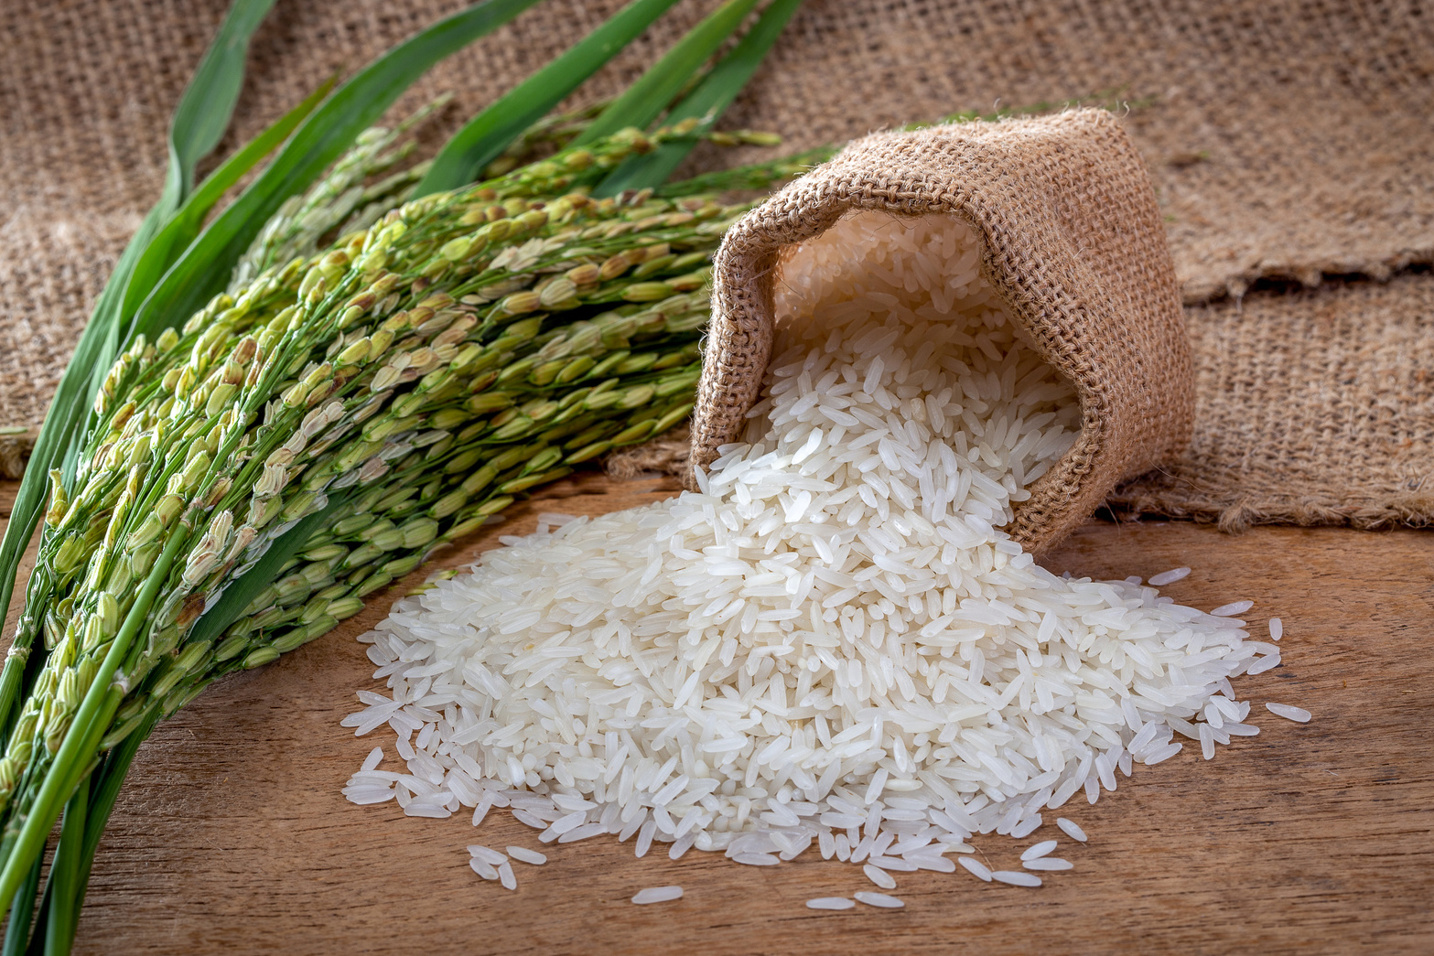
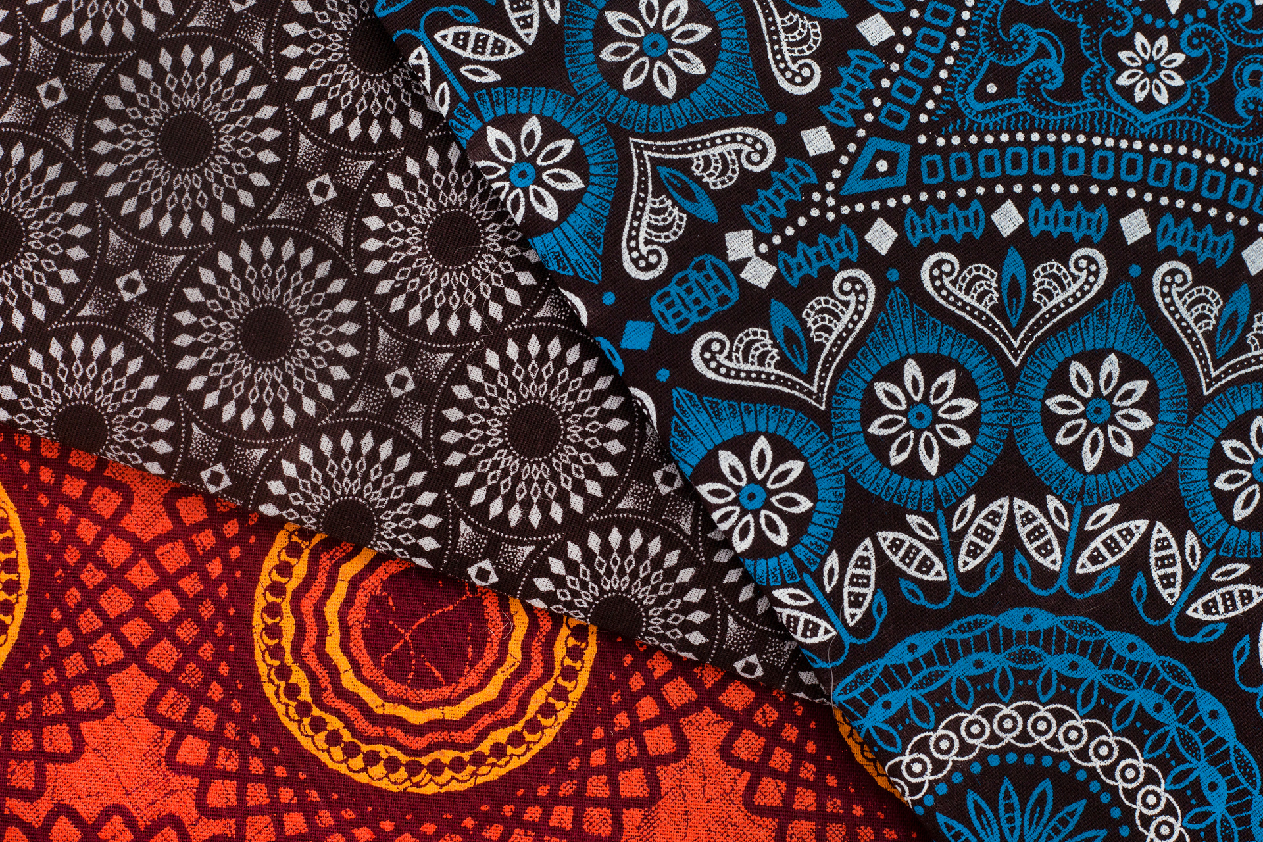
What is DRC’s biggest export?
A. Coffee
B. Copper
C. Rice
D. Fabric

Slide 10
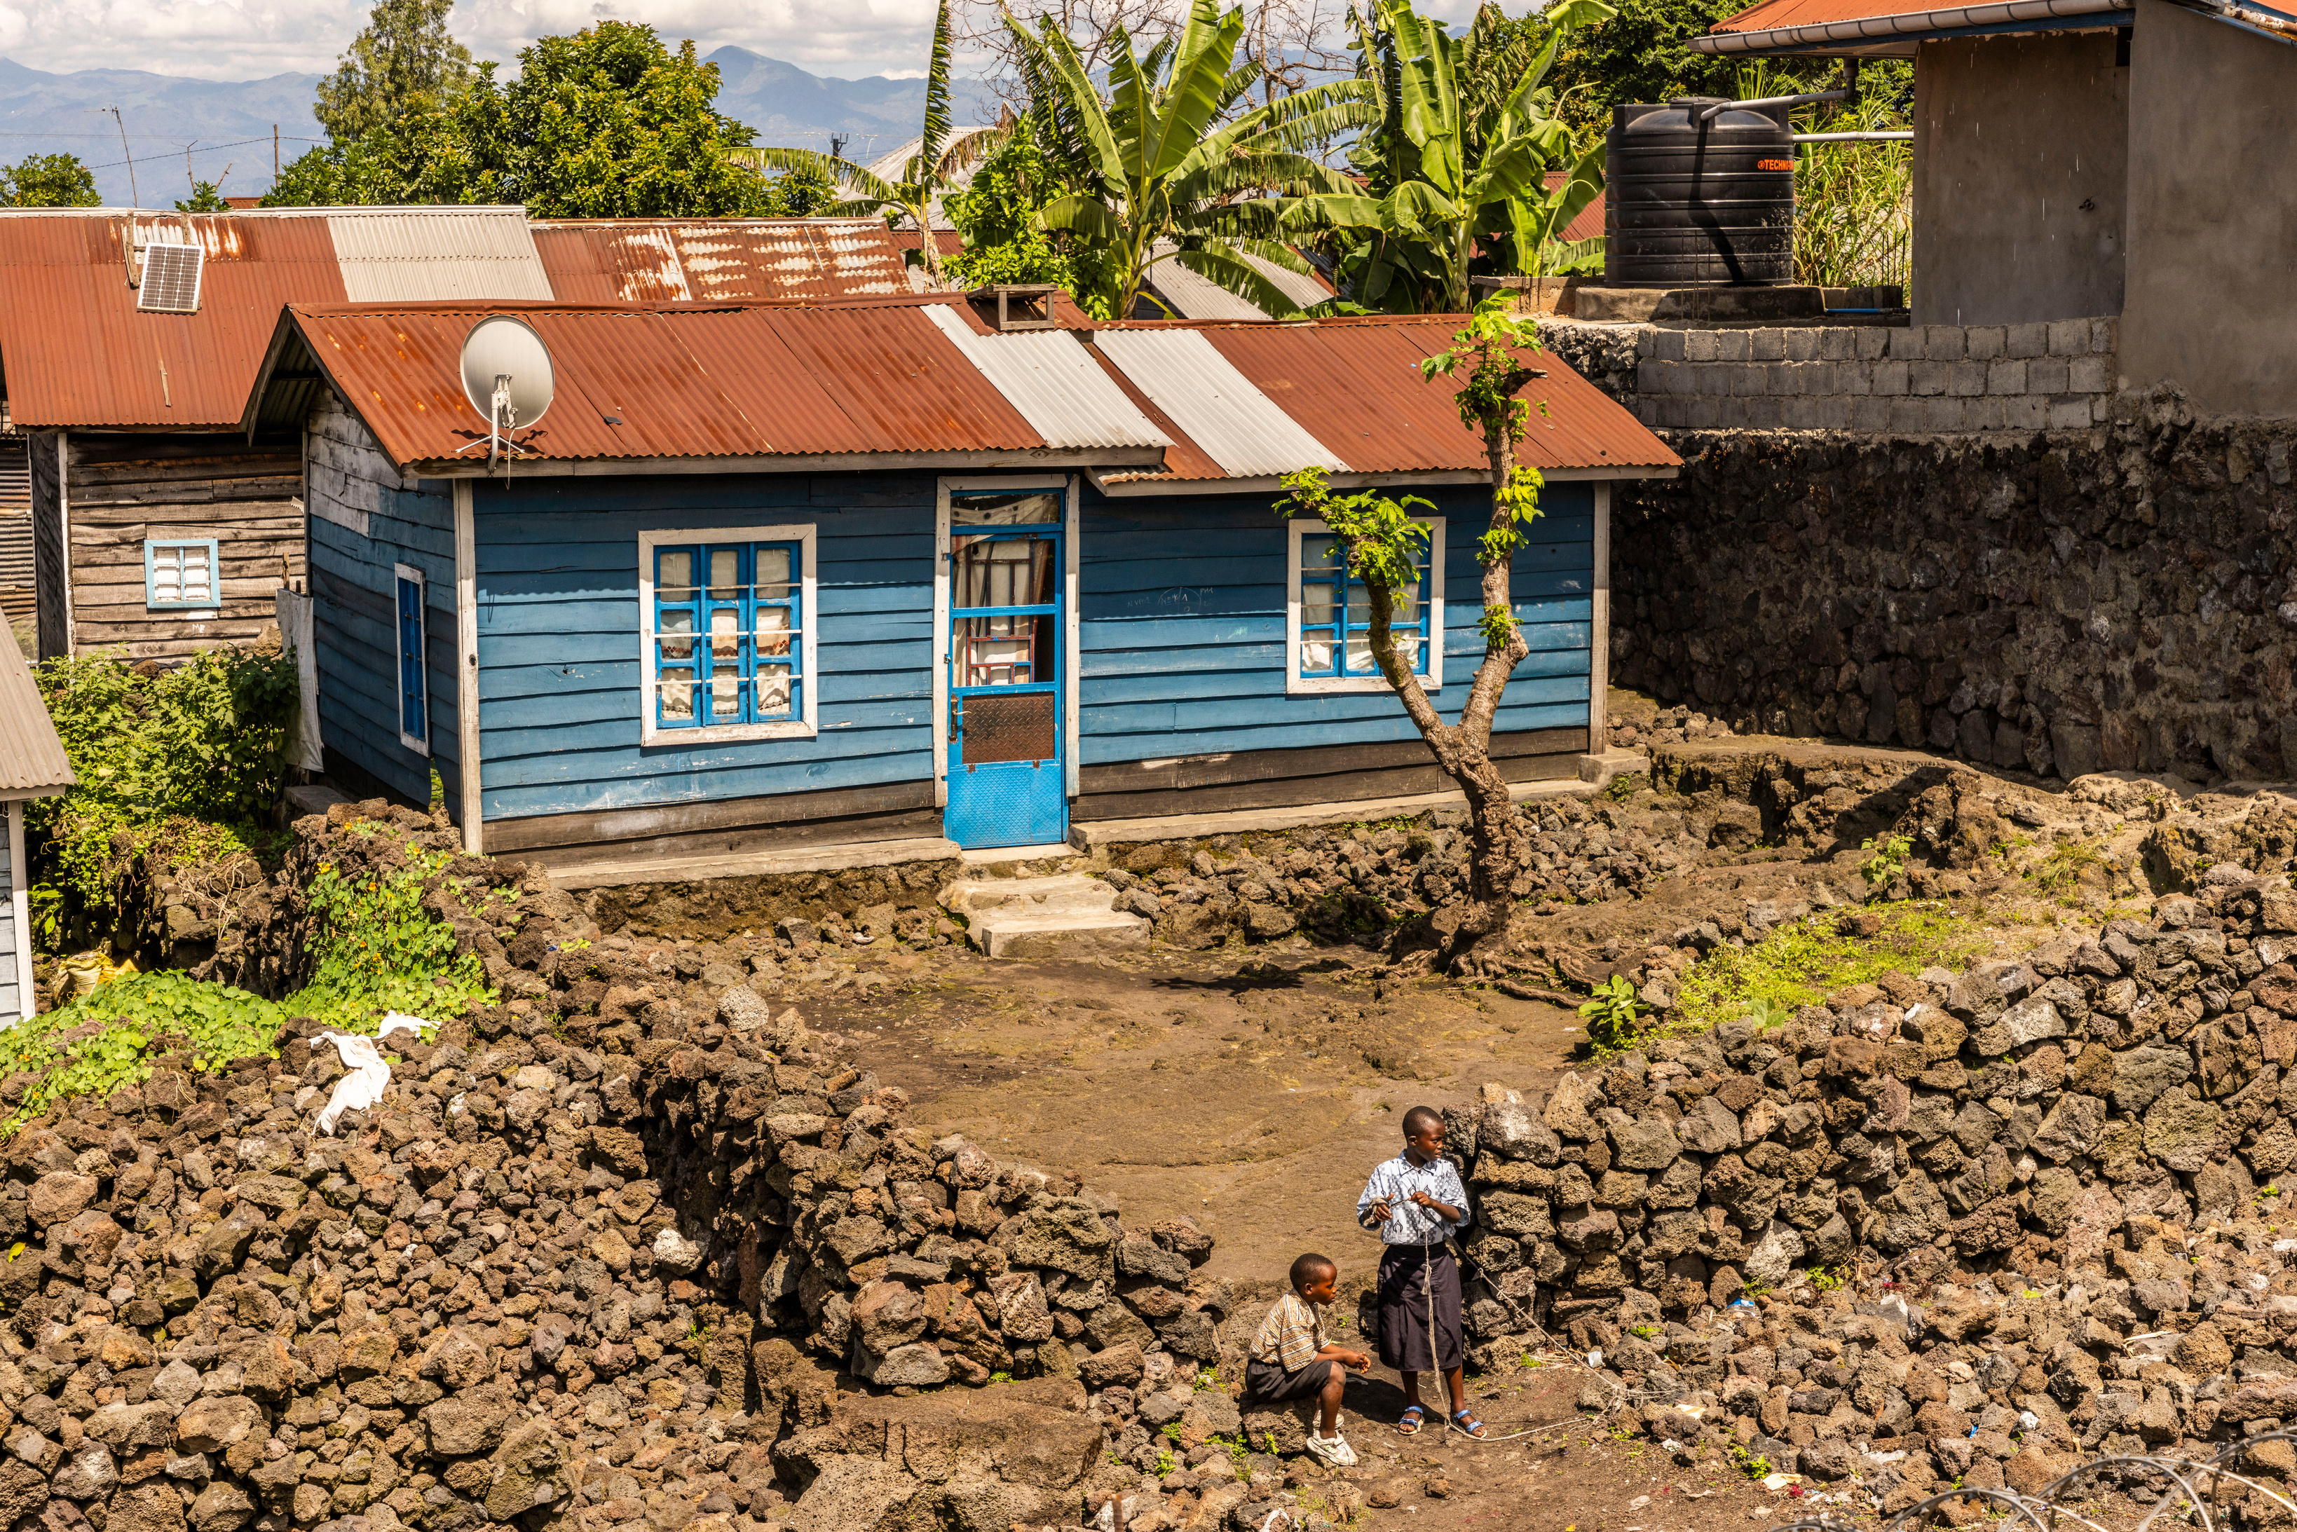
Which of these happened in DRC in 2021?
A. Earthquake
B. Volcano eruption
C. Tsunami
D. Tornado

Slide 11
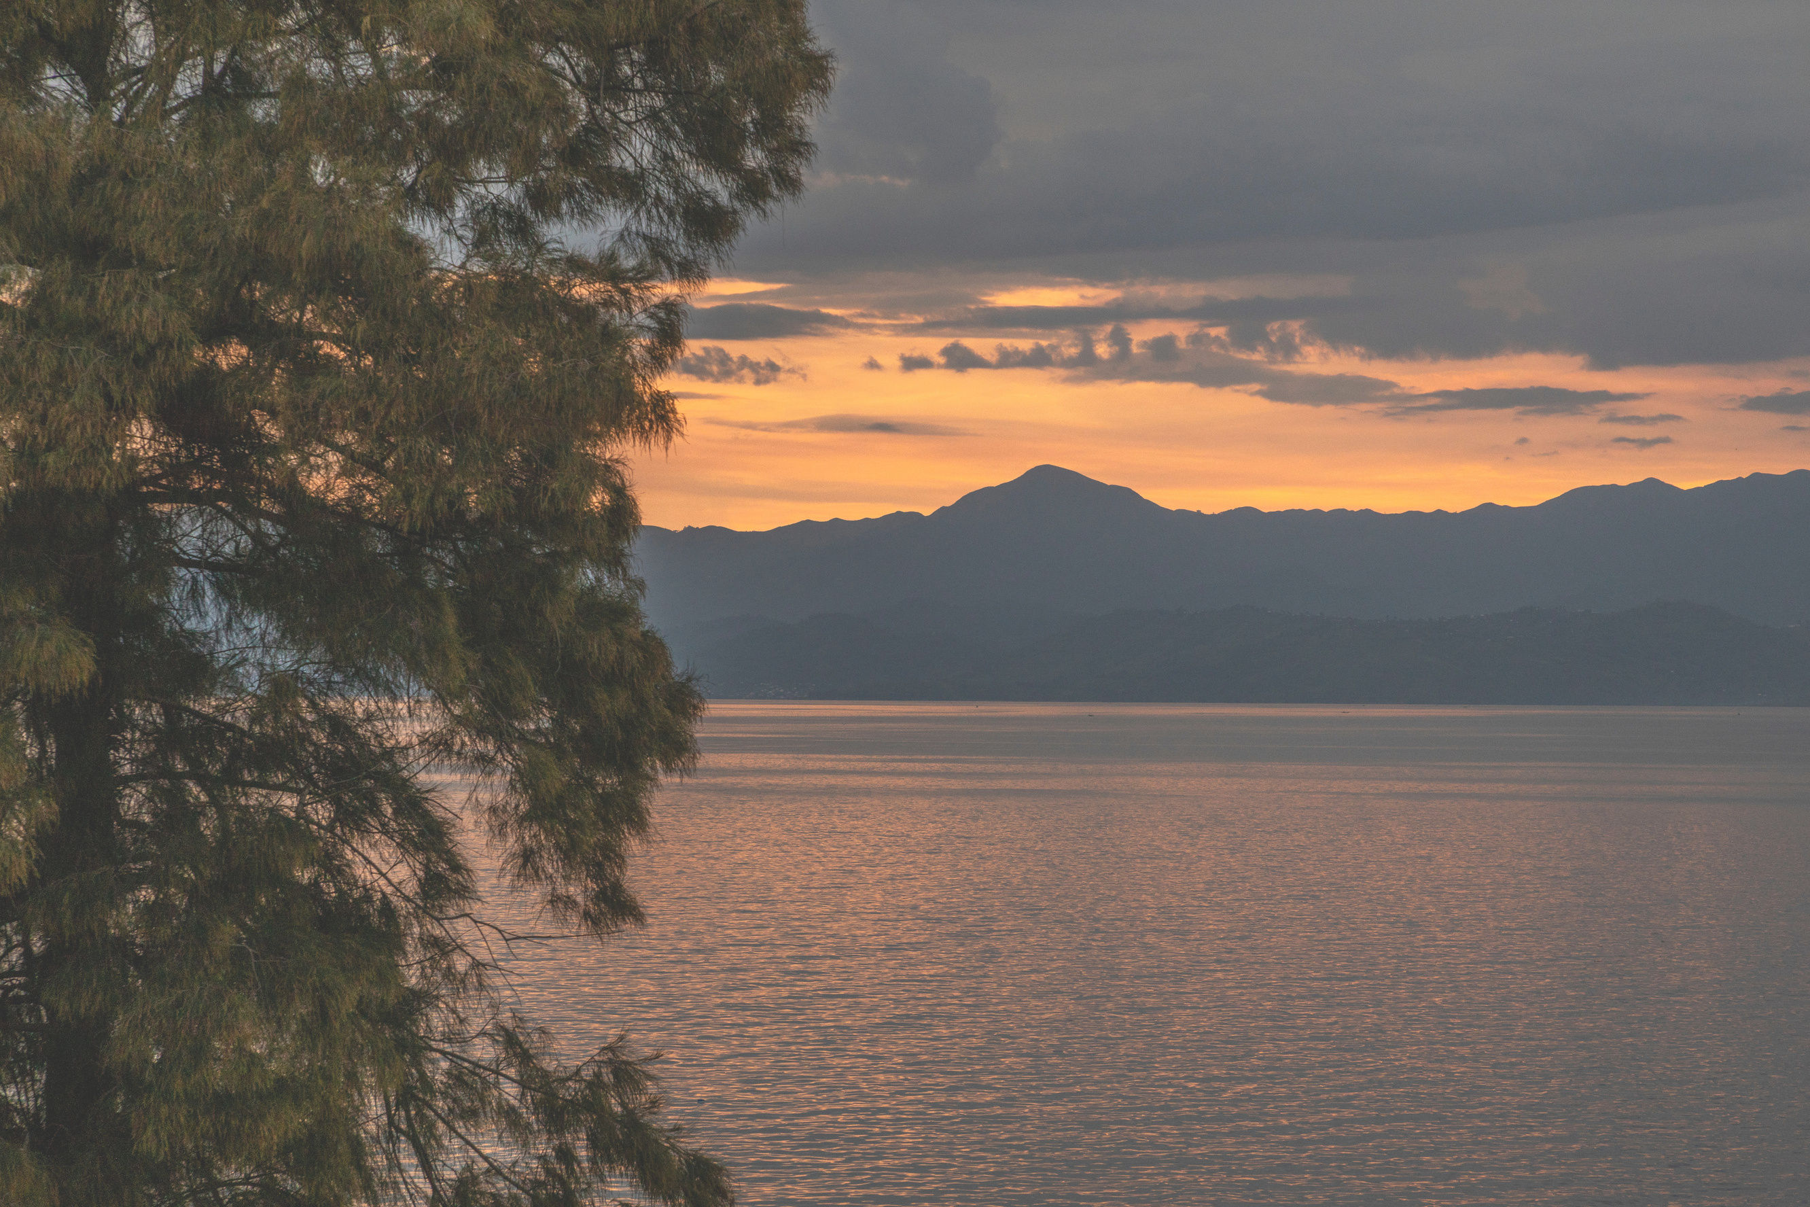
DRC is home to ...
A. The second biggest lake in the world
B. The second longest river in the world
C. The second largest rainforest in the world
D. The second largest mountain in the world

Slide 12
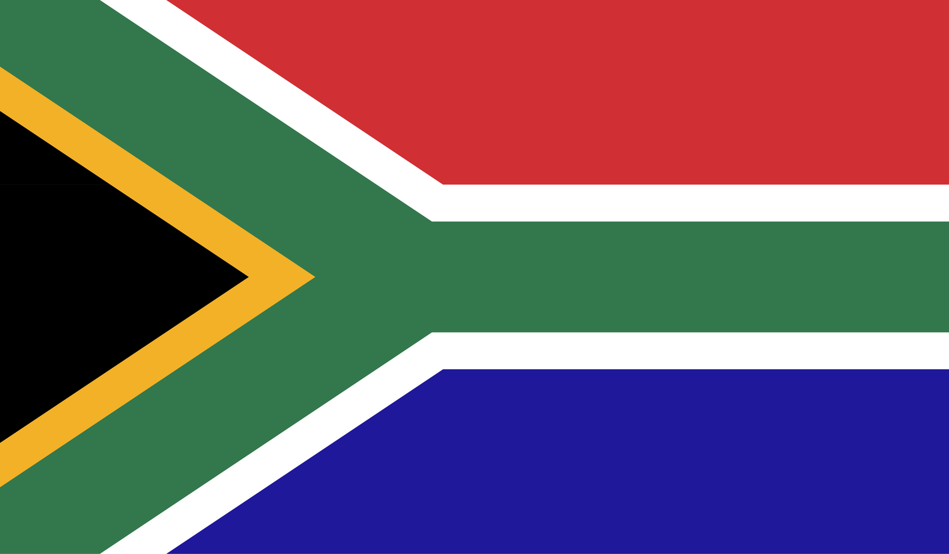
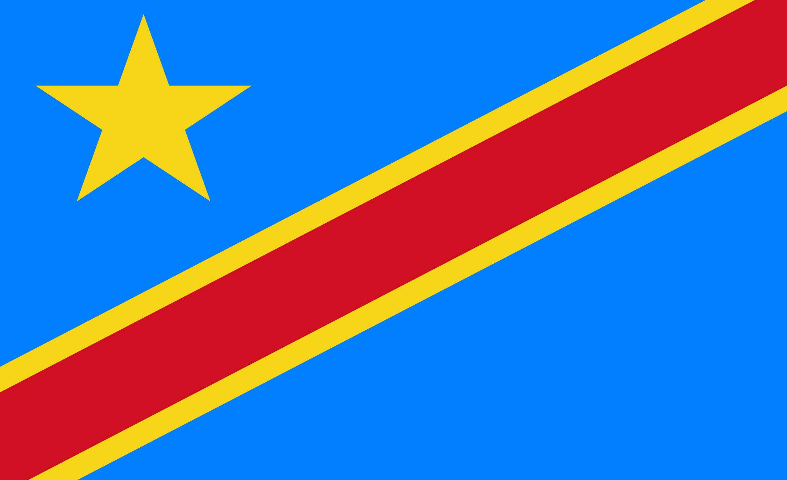
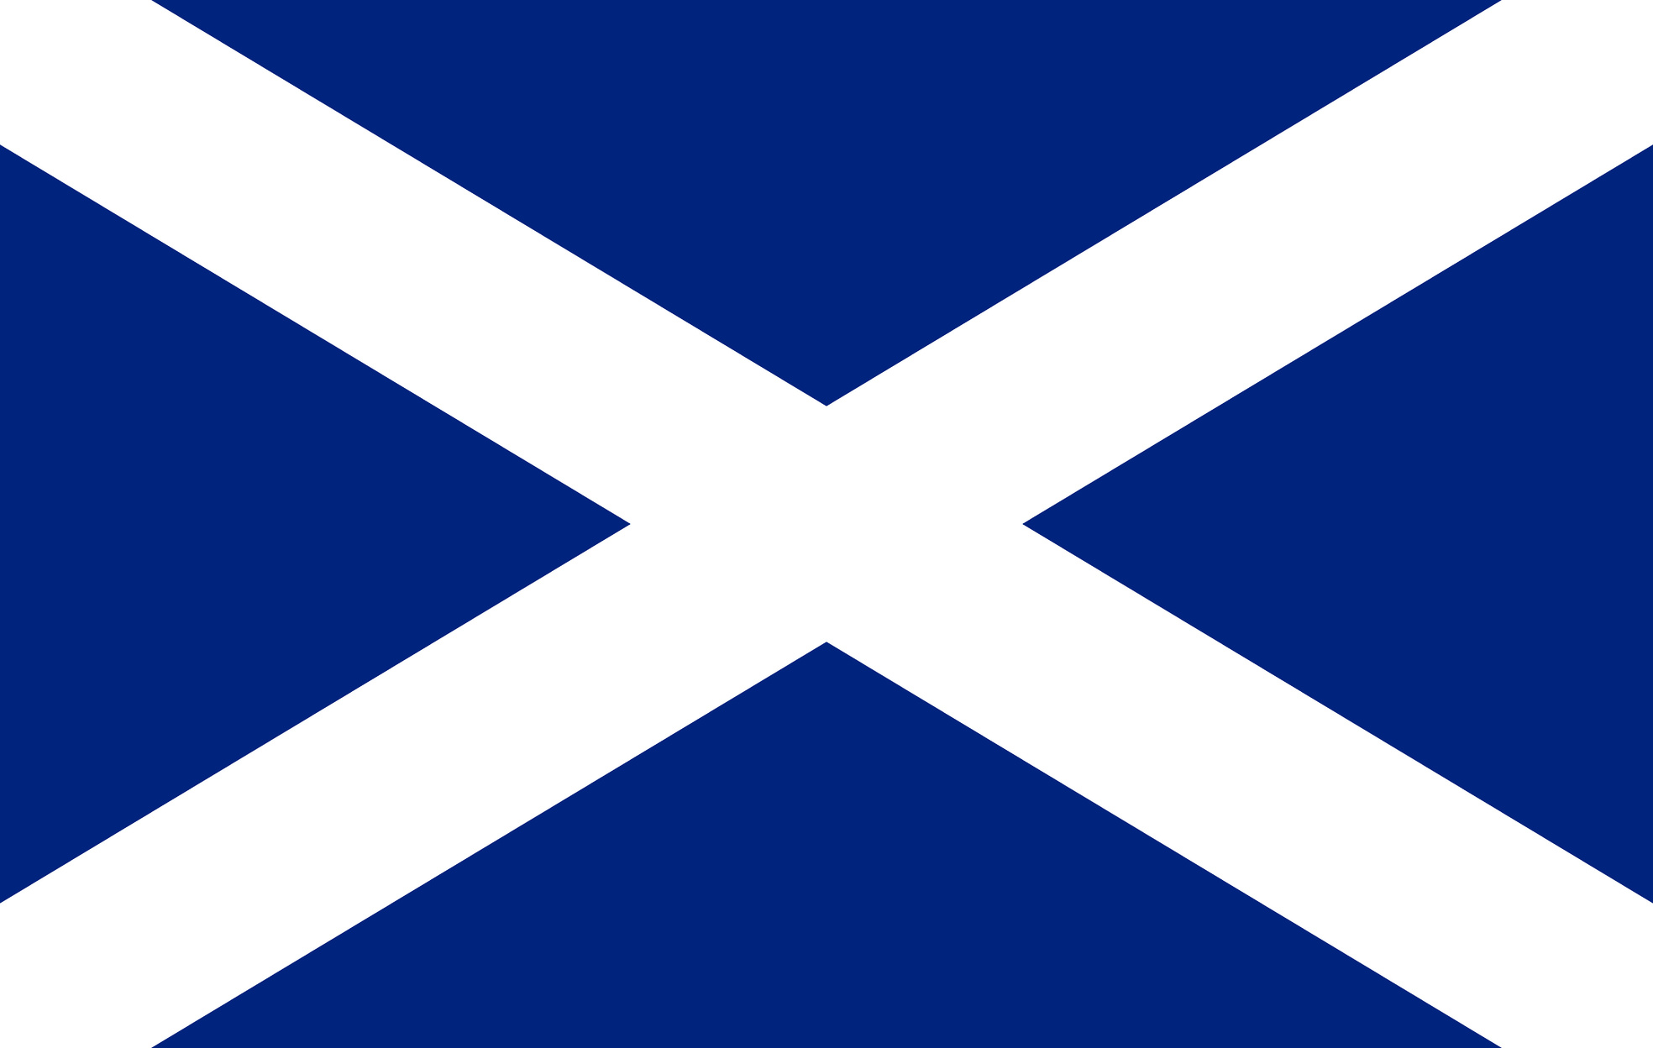
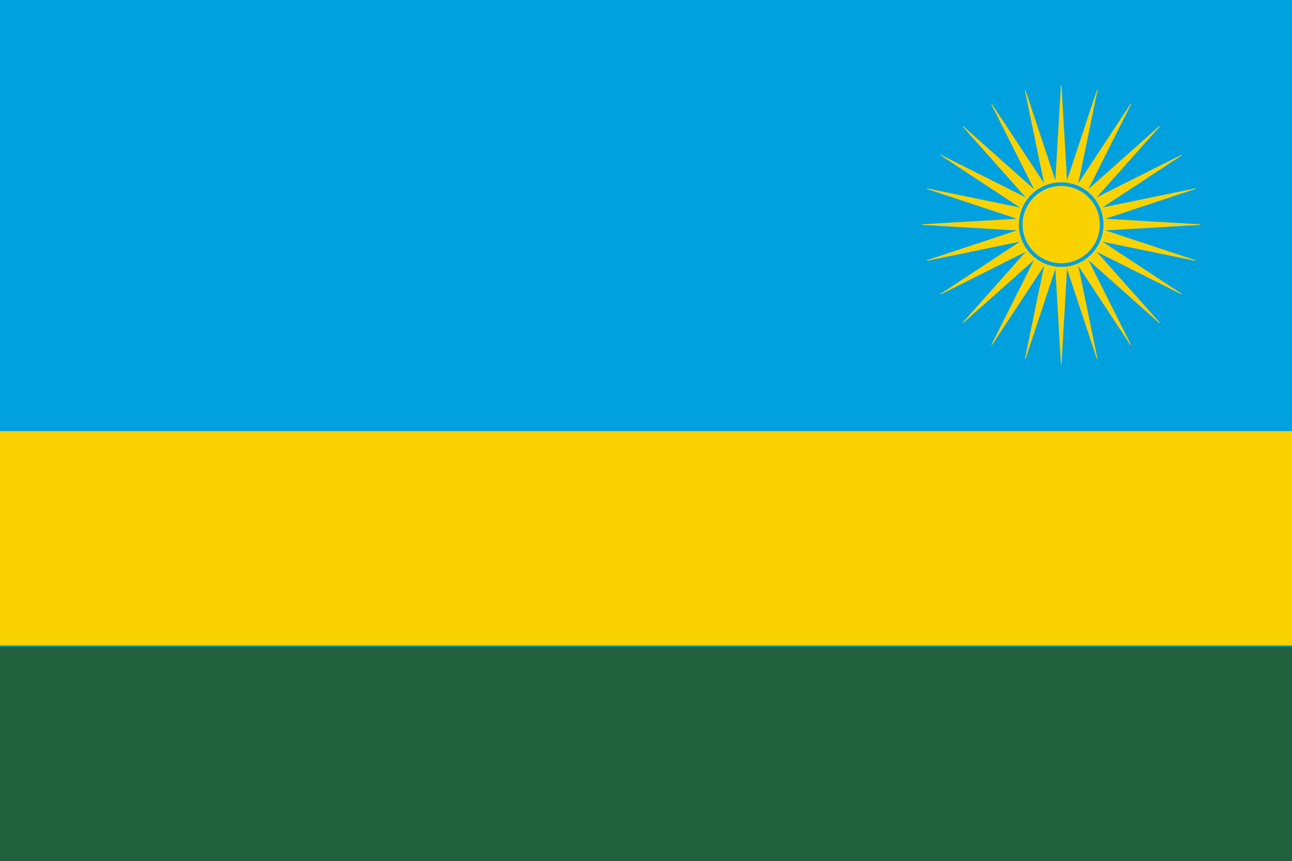
A.
B.
Which flag belongs to DRC?
C.
D.

Slide 13
How many people live in DRC?
C. 110,000,000
Notes:
C - 110 million people live in DRC, making it the 15th largest population in the world!

Slide 14
How many languages are spoken in DRC?
D. 200
Notes:
D - Over 200 languages and dialects are spoken in D.R. Congo! There are 5 main languages, which are French, Kikongo (Kituba), Lingala, Swahili, and Tshiluba, as well as many other dialects. Can you say anything in another language?

Slide 15
What is the capital of DRC?
D. Kinshasa
Notes:
D - Kinshasa. See if you can name the other countries whose capitals are named here! (Kampala = Uganda, Bujumbura = Burundi, Kigali = Rwanda.) Comfort International works in all of these countries as well as South Sudan whose capital is Juba.

Slide 16
What is the most popular sport in DRC?
A. Football
Notes:
A - Football is the most popular sport in the DRC. The national team have won the African cup of nations twice.

Slide 17
What animals can you find in DRC?
B. Mountain Gorillas
Notes:
B - Mountain Gorillas. DRC and Rwanda are home to the last remaining mountain gorillas in the world. You can also find elephants, giraffes, antelope, lions, rhino, hippos and many more animals!

Slide 18
What is DRC’s biggest export?
B. Copper
Notes:
B - Copper is the DRC’s biggest export. DRC is home to many mines of natural minerals and precious metals, making it very vulnerable to exploitation from people wanting to control the mines from DRC and other countries.

Slide 19
Which of these happened in DRC in 2021?
B. Volcano eruption
Notes:
B - Volcano Eruption. There is an active volcano in DRC called Mount Nyiragongo which erupted in 2002 and then again in 2021. You can see some of the volcanic rock in the picture on the slide.

Slide 20
DRC is home to ...
C. The second largest rainforest in the world
Notes:
C - The second largest rainforest in the world. Congo is home to the Congo Basin rainforest which is the largest in the world after the Amazon rainforest.

Slide 21
A.
Which flag belongs to DRC?
Notes:
A = DRC
B = South Africa
C = Scotland
D = Rwanda

Slide 22

Asante sana! Thanks for listening!
SCIO SC030369
comfortinternational.org

